Slide 1
Amazon Web Services AI/ML
Client Name

Slide 2
Agenda
Introduction to AWS
AWS Machine Learning Stack
Q&A

Slide 3
What AWS offers
Experience: Building and managing cloud since 2006
Service breadth and depth: 175+ services
Pace of innovation
Global footprint: 24 regions, 77 Availability Zones, and 216 edge locations
Community: tens of thousands of consulting and technology partners from across the globe
Notes:
So what makes us so unique?
First, it’s our experience. We started in 2006 and helped many public organizations over the world migrating to the cloud.
Then our service breath and depth. We have been continually expanding our services to support virtually any cloud workload, and have now more than 175 fully featured services, including compute, storage, databases, networking, analytics, robotics, machine learning and artificial intelligence (AI), IOT… ,just to name a few. In addition to having the greatest breadth of services, we also have the deepest functionality within those services. If you look at our database service for example, you can choose from 15 purpose-built databases engines to give you the right tool for the right job.
AWS is also innovating very fast. In 2018 for example, we launched almost 2000 new features and services and this number is growing every year.
Our global footprint, I already talked about it but the fact that we have multiple availability zones in every region gives you the possibility to build high available applications within a region.
In terms of pricing we have reduced our prices 80 different times since we start offering our services. We expect to continue to lower prices this year and for many years to come.
Finally, we have a very large community of consulting and technology partners that have the necessary certifications and are there to assist you with your projects.

Slide 4
Why are organizations adopting cloud computing?
Trade capital expense for variable expense
Benefit from massive economies of scale
Stop guessing capacity
Increase speed and agility
Go global in minutes

Slide 5
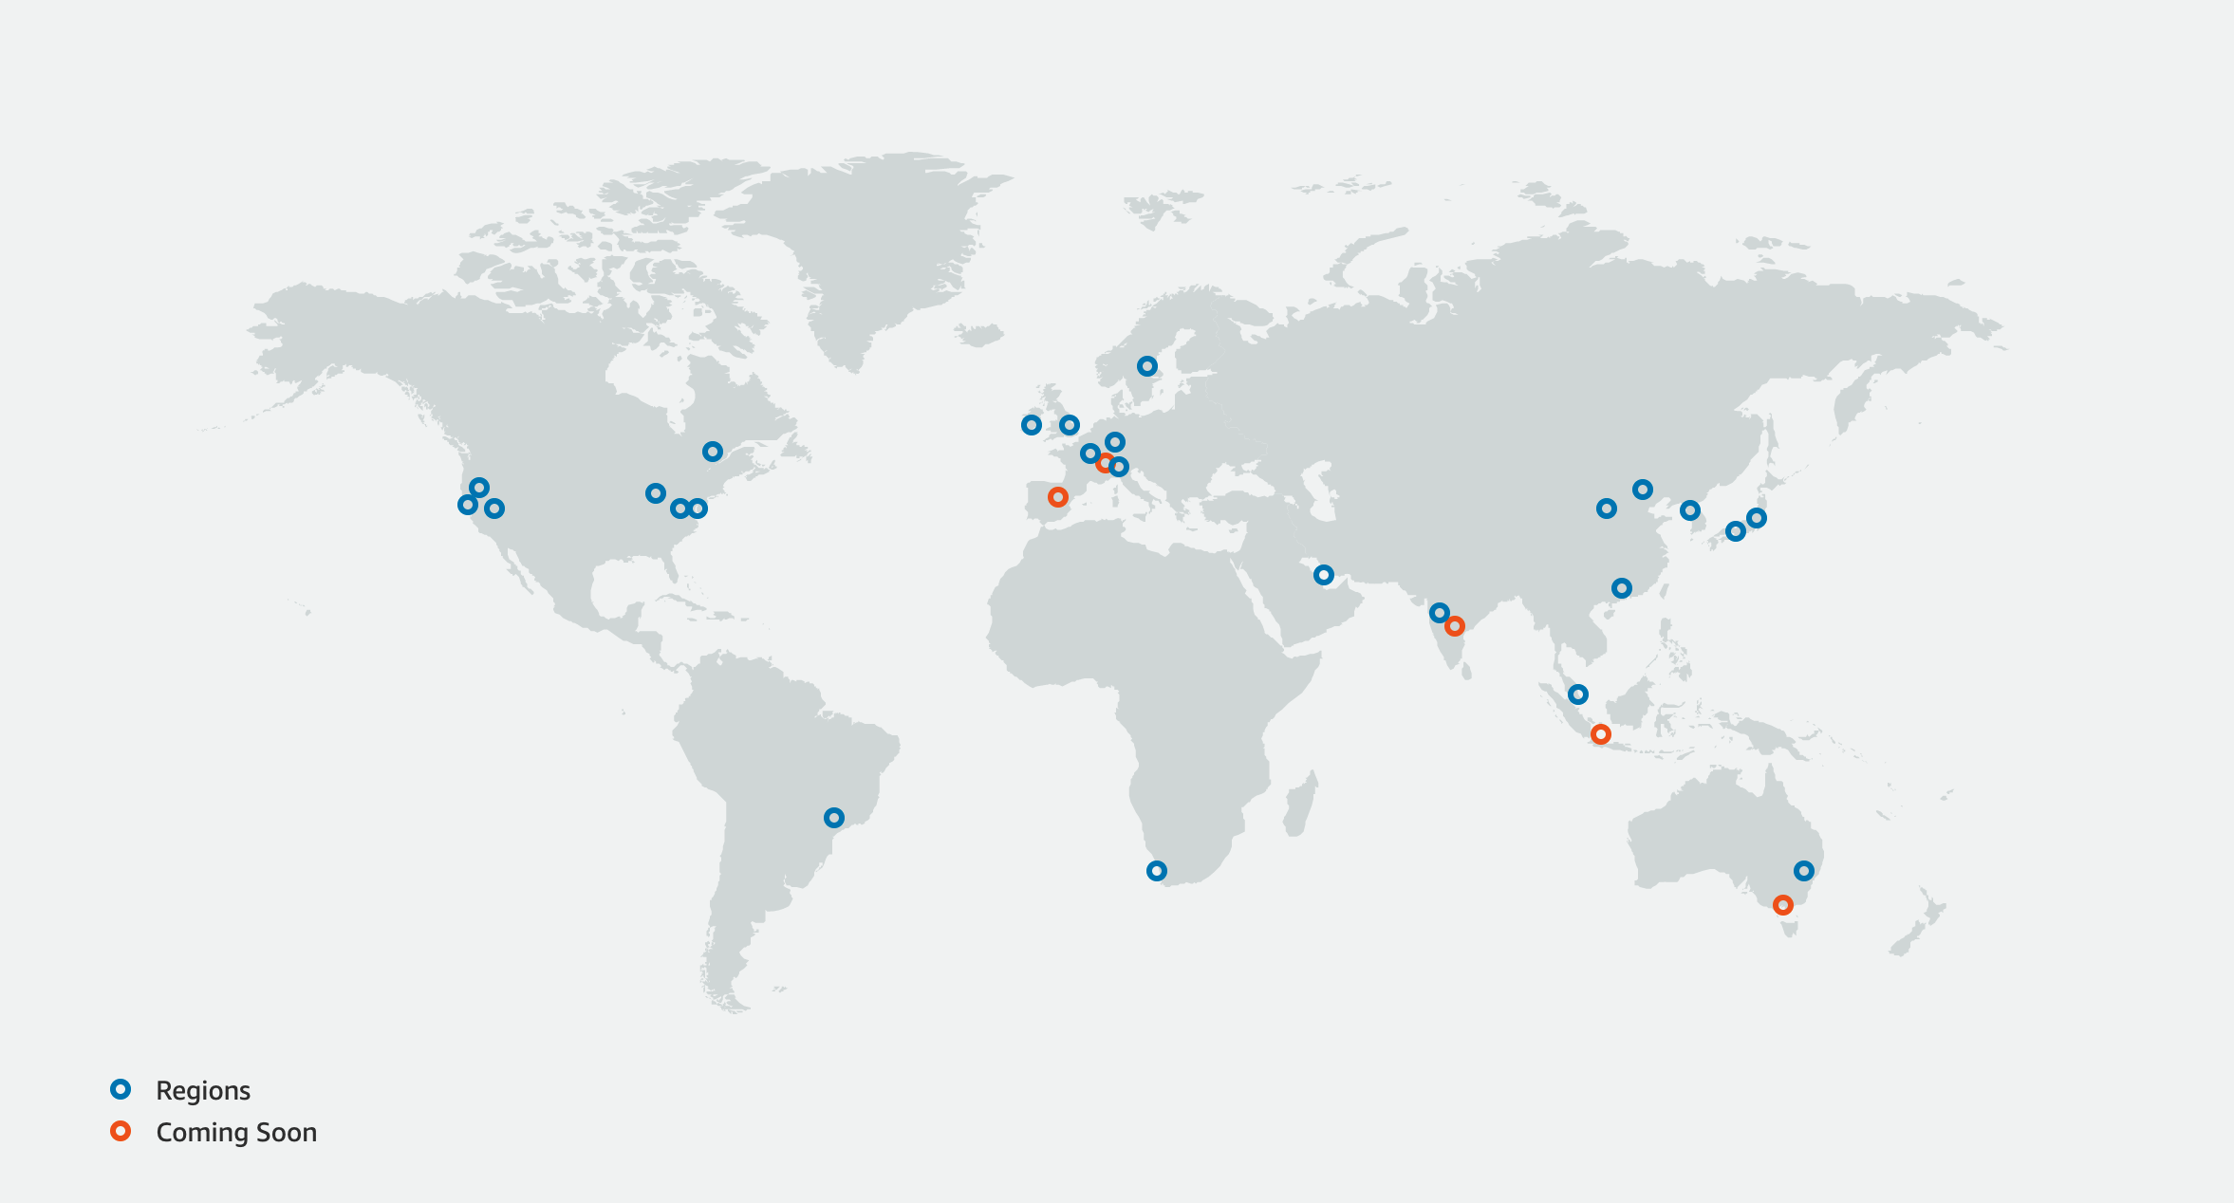
AWS Global Infrastructure
25
Region
Regions
80
Availability Zone A
Availability Zone B
Availability Zones
Availability Zone C
Data Center
Data Center
Data Center
Notes:
Ireland, London, Frankfurt, Paris, Sweden, Italy, Madrid and Switzerland announced

Slide 6
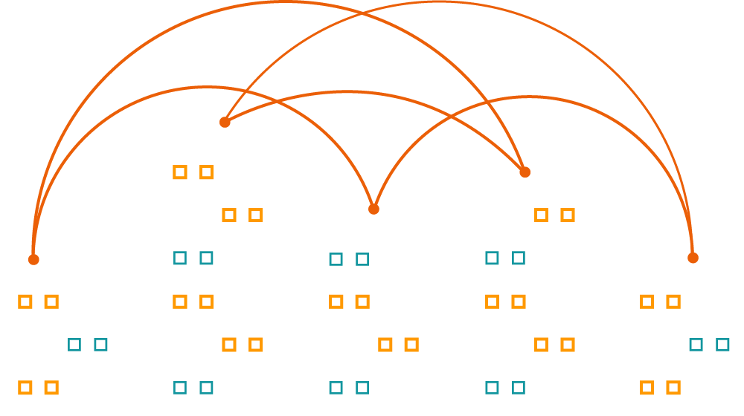
AWS availability zone design
Fully isolated infrastructure with one or more datacenters
Meaningful distance of separation
Datacenters connected via fully redundant and isolated metro fiber
Unique power infrastructure
Many 100Ks of servers at scale

Slide 7
AWS Services

Slide 8
Agenda
AWS Global Infrastructure and Services
AWS Machine Learning Stack
Q&A

Slide 9

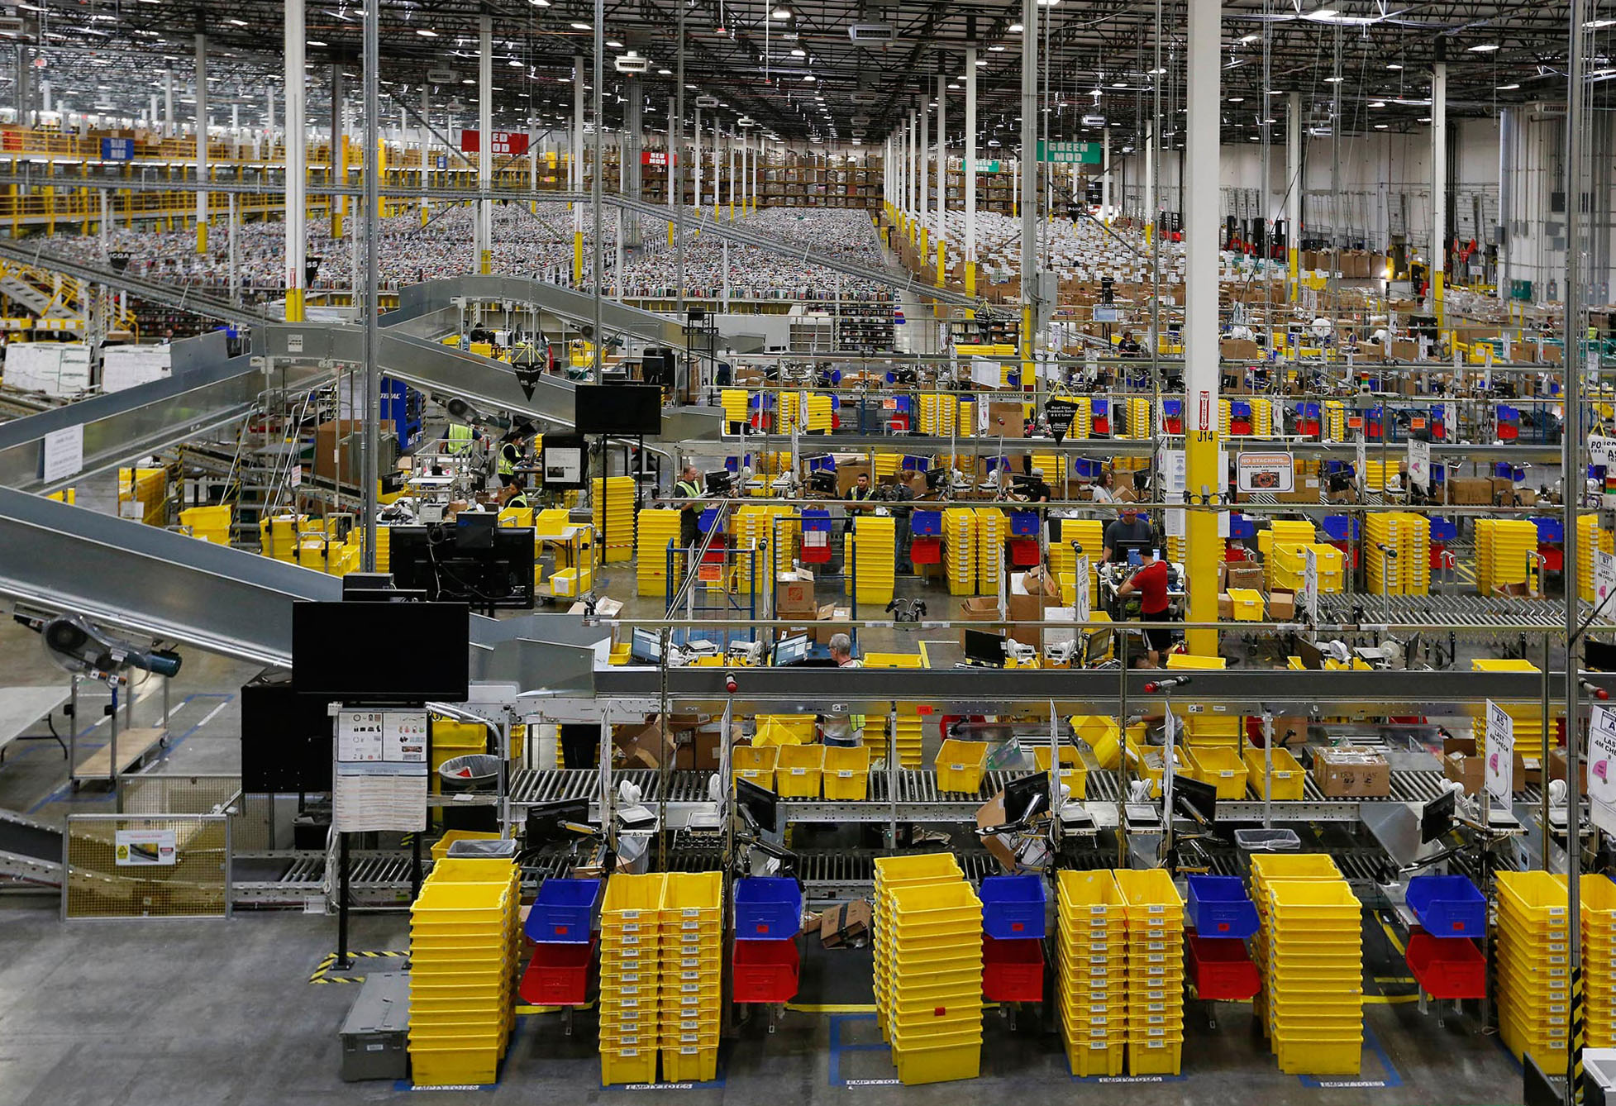
Amazon’s machine learning innovation at scale
4,000 products per minute sold on Amazon.com
1.6M packages every day
Billions of Alexa interactions each week
First Prime Air Delivery on Dec. 7, 2016
Notes:
Amazon has been applying ML in areas such as personalization and supply chain for more than 20 years. ML is an integral part of Amazon.
We’ve improved that original personalization model significantly over time and moved it to other products such as Amazon Prime.
We use ML throughout our fulfillment process including developing a forecast system that can predict the appropriate amount of demand for each product we sell worldwide in order to deliver on our customer expectation on convenience, cost, and delivery speed.
We’ve developed natural language processing technology to give consumers an entirely new way to interact with technology through Alexa.
We’re also developed ground breaking technology with autonomous flight via Prime Air Drones and using robotics in our fulfillment center to get packages to consumers faster.
This was a big culture change for us, but it’s something every organization can do.
Amazon itself is an example of a company that went through a multi-year machine learning journey in order to be the ML-driven company you see today. And it did this by bringing domain and technical experts together to ‘work backwards’ from the customer problem.
Amazon had been applying ML in areas such as personalization and supply chain for more than 20 years. ML is an integral part of Amazon.
4 examples:
We’ve improved that original personalization model significantly over time and moved it to other products such as Amazon Prime.
We use ML throughout our fulfillment process including developing a forecast system that can predict the appropriate amount of demand for each product we sell worldwide in order to deliver on our customer expectation on convenience, cost, and delivery speed.
We’ve developed natural language processing technology to give consumers an entirely new way to interact with technology through Alexa.
We’re also developed ground breaking technology with autonomous flight via Prime Air Drones and using robotics in our fulfillment center to get packages to consumers faster.
Conclusion
This was a big culture change for us, but it’s something every organization can do.

Slide 10
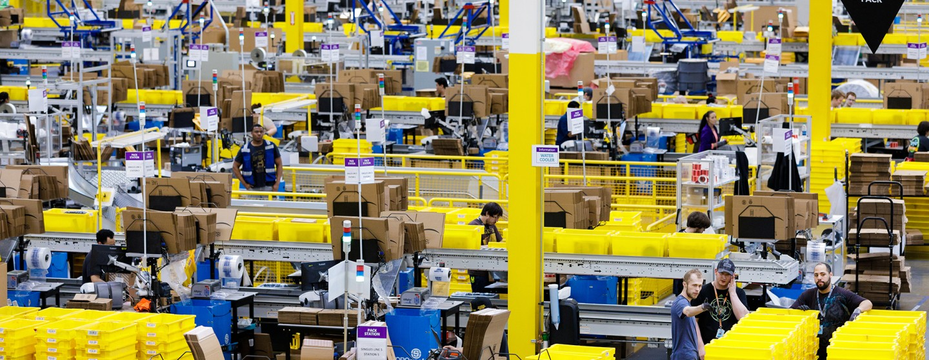
AMAZON’S MACHINE LEARNING INNOVATION
Notes:
Amazon itself is an example of a company that went through a multi-year machine learning journey in order to be the ML-driven company you see today. And it did this by bringing domain and technical experts together to ‘work backwards’ from the customer problem.
Amazon had been applying ML in areas such as personalization and supply chain for more than 20 years. ML is an integral part of Amazon.
4 examples:
We’ve improved that original personalization model significantly over time and moved it to other products such as Amazon Prime.
We use ML throughout our fulfillment process including developing a forecast system that can predict the appropriate amount of demand for each product we sell worldwide in order to deliver on our customer expectation on convenience, cost, and delivery speed.
We’ve developed natural language processing technology to give consumers an entirely new way to interact with technology through Alexa.
We’re also developed ground breaking technology with autonomous flight via Prime Air Drones and using robotics in our fulfillment center to get packages to consumers faster.
Conclusion
This was a big culture change for us, but it’s something every organization can do.

Slide 11
Our mission at AWS
Put machine learning in the hands of every developer
Notes:
Our mission is to take our rich experience and expertise with machine learning across Amazon and put it in the hands of all organizations--every developer, data scientist, reseacher.
Said another way, we want to simplify machine learning. We want to make it easy for all developers to easily build intelligent applications

Slide 12

















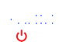




























































































































MACHINE LEARNING IS HAPPENING IN COMPANIES OF EVERY SIZE AND INDUSTRY
Tens of thousands customers have chosen AWS for their ML workloads | More than twice as many customers using ML than any other cloud provider
Notes:
And this approach resonates with our customers
More ML happens on AWS than anywhere else. From the largest enterprise through to the hottest startups, AWS has over twice the number of machine learning based public references than any other provider.
Companies are working with us to build solutions that are core to their business.
Verizon, PWC, Intel, Domino's, Pinterest, Toyota, Airbnb, Comcast, Samsung, Slack, Formula 1, Fender, Kia, 3M,...
NASCAR uses Amazon SageMaker, Amazon Rekognition, and Amazon Transcribe to enhance metadata and captions for their new video series, saving thousands of hours of manual search time and better surfacing video clips to their 80 million fans.
Intuit uses Amazon SageMaker for ExpenseFinder, which automatically pulls a year’s worth of bank transactions and finds deductible business expenses through their machine learning algorithm, identifying on average $4,300 in business expenses that it can save each customer.
And lastly is invention, which allows our customers to move from evolutionary improvements to revolutionary innovations. This happens when they leverage their vast industry knowledge coupled with AI/ML to think of ways to bring new products, new categories and even new businesses to market. Convoy, a Seattle-based logistics company, is building their entire company and value proposition off the use of machine learning. The company is disrupting the inefficient trucking model by using machine learning to automate it. Convoy uses machine learning to provide better matches for shippers and truckers, allowing them to move freight more efficiently—and lowering costs for both parties—using Convoy’s matching system.
Cerner is tapping into AWS’s deep portfolio of machine learning and AI services to surface insights that will help their healthcare provider customers streamline operations and provide more personalized patient care. They’ve already developed a model that predicts Congestive Heart Failure up to 15 months before clinical manifestation. Pairing this predictive tool with real-time integration in to individual health records can support provider decision making in real-time.

Slide 13




BUILDING YOUR TEAM’S SKILLS
Hands-on learning
Training + certification
AWS DeepRacer Reinforcement Learning
AWS DeepComposer
Generative AI
AWS DeepLens
Deep Learning
AWS ML Training and Certification
Partnerships with MOOCs
Notes:
AWS’s broad set of options to help customers get up to speed with ML from online courses, to hands-on devices like DeepRacer, DeepLens, and DeepComposer, to programs like ML Solutions Lab and ML Embark.
In parallel, you want to focus on building the right skills for your engineers.
We sometimes hear that organizations don’t move ahead because they feel like they don’t have the technical expertise to be successful.
The truth is, you can’t buy your way in to talent. There’s not enough and it can get very expensive. Instead you have to focus on developing internal talent.
But, we have seen that developers are able to obtain the right skills with a high success rate when engaged with good, hands-on training.
Amazon developed a machine learning university that we have used for over six years to train our engineers on ML.
Last year, we made a lot of this content available for free to customers and we have seen well over 100,000 developers start their ML journey with these content since. Having strong training programs can also help you attract and retain talent.
We’ve also brought additional programs to market like DeepRacer and DeepLens to get aspiring ML developers hands on with the technology.
AWS DeepRacer provides developers with the opportunity to learn, upskill, and get hands on with ML through a fully autonomous 1/18th scale race car driven by reinforcement learning, 3D racing simulator, and global racing league.
We hold corporate events designed to provide developers with a fun way to get introduced to essential ML concepts. Customers like Accenture, MorningStar and Liberty Mutual.
AWS DeepLens is commonly used for object detection and sentiment analysis projects.
Models trained in Amazon SageMaker can be sent to AWS DeepLens with just a few clicks from the AWS Management Console.
https://aws.amazon.com/events/summits/online/emea/?trkCampaign=emea20_virtualsummit&trk=

Slide 14

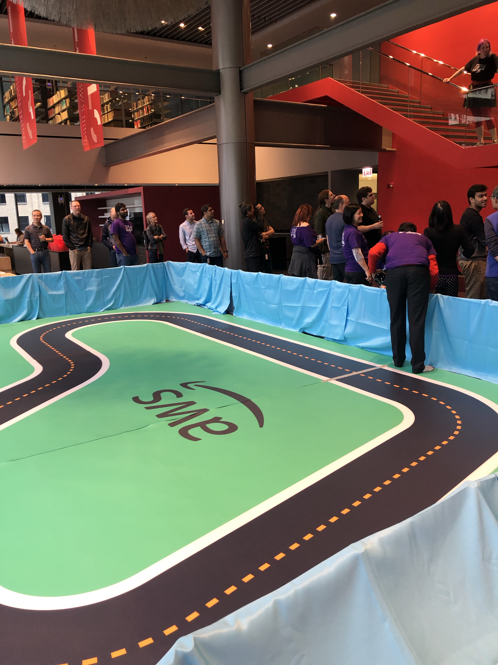
AWS DeepRacer
A fully autonomous 1/18th-scale race car designed to help you learn about reinforcement learning through autonomous driving
AWS DEEPRACER
A fully autonomous 1/18th-scale race car designed to help you learn machine learning through autonomous driving
aws.amazon.com/deepracer
Notes:
AWS DeepRacer is a 1/18th scale race car which gives you an exciting and fun way to get started with reinforcement learning (RL).
RL is an advanced machine learning (ML) technique which takes a very different approach to training models than other machine learning methods.
Its superpower is that it learns very complex behaviors without requiring any labeled training data, and can make short-term decisions while optimizing for a longer-term goal.
With AWS DeepRacer, you now have a way to get hands-on with RL, experiment, and learn through autonomous driving.
You can get started with the virtual car and tracks in the cloud-based 3D racing simulator, and for a real-world experience, you can deploy your trained models onto AWS DeepRacer and race your friends, or take part in the global AWS DeepRacer League. Developers, the race is on.

Slide 15



AWS DEEPRACER
Robotic autonomous
race car
Racing simulator
powered by AWS Robomaker, to train with Amazon Sagemaker RL
Racing League
Live and Virtual Races
AWS DeepRacer is a Free Tier Eligible service that allows developers to get started with 10 hours worth of credits
Notes:
CRITICAL! The car is just the hook. and how we will scale is the virtual offering. No restrictions. EVERYONE can get started with RL and sagemaker
-----
AWS DeepRacer, a fully autonomous 1/18th scale race car, driven by reinforcement learning.
With a camera in the front to ‘see’ the track, and an Intel-based compute platform inside to perform the model inference.
It’s built on-top of a 4x4 monster truck RC car chassis.
Of course, to enable the end-to-end experience we also introduced the AWS DeepRacer Console.
- It provides a simple way for developers to get introduced to RL via model configuration, training in a virtual environment, and evaluation of how well the model drives on a virtual track.
- It provides the tools developers need to get started quickly, and iterate their RL models
As we built and started testing the car, we realized…
…what’s a car without a little competition?
And so, we’re also announcing…
The AWS DeepRacer league – world’s first global autonomous racing league for developers
Developers train their models via the console for the fastest lap time, and can submit lap times to online leaderboards, or compete in-person at AWS Summits.
Winners of each stage progress to the DRL Cup at re:Invent 2019, to win the Champions Cup.
The world’s first global, autonomous racing league for developers:
Train RL models for the fastest lap time
Win monthly online stages or in-person at AWS Summits
Winners of each stage progress to DeepRacer League Cup at re:Invent 2019 to win the Champions Cup

Slide 16

NEW: INTRODUCING AWS MACHINE LEARNING EMBARK PROGRAM
DISCOVERY
Cross-functional workshops
TRAINING
In-person training
DEVELOPMENT
ML Solutions Lab
ENGAGEMENT
Get hands-on with DeepRacer
Notes:
JRC
The AWS Machine Learning Embark program is designed to start your company on the journey to machine learning success. The content is based on years of proven success helping organizations adopt ML, as well as Amazon’s own journey to put ML first in all areas of our business. The program starts with an interactive workshop to identify the right business problem to tackle, followed by on-site, hands-on training to ramp up your company’s machine learning skills fast through practical application. Your developers then have the opportunity to partner with AWS machine learning experts from the ML Solutions Lab to build at least one proof of concept. The program also includes a corporate AWS DeepRacer event to get your company motivated to embrace machine learning through hands-on friendly competition. With the practical skills, knowledge, and motivation derived from the program, your company will be ready to take your machine learning to the next stage.

Slide 17





















The AWS ML Stack Broadest and most complete set of machine learning capabilities
AI SERVICES
HEALTH AI
INDUSTRIAL AI
ANOMALY DETECTION
CODE AND DEVOPS
NEW
Amazon HealthLake
Amazon Transcribe for Medical
Amazon Comprehend for Medical
NEW
AWS Panorama + Appliance
NEW
Amazon Monitron
NEW
Amazon Lookout for Equipment
NEW
Amazon Lookout for Vision
NEW
Amazon Lookout for Metrics
NEW
Amazon DevOps Guru
Amazon CodeGuru
 | VISION | SPEECH | TEXT | SEARCH | CHATBOTS | PERSONALIZATION | FORECASTING | FRAUD | CONTACT CENTERS
Amazon Rekognition
Amazon Polly
Amazon Transcribe
+Medical
Amazon Comprehend
+Medical
Amazon Translate
Amazon Textract
Amazon Kendra
Amazon Lex
Amazon Personalize
Amazon Forecast
Contact Lens
Amazon Fraud Detector
Voice ID
For Amazon Connect
ML SERVICES
SAGEMAKER STUDIO IDE
Label data | NEW Aggregate & prepare data | NEW Store & share features | Auto ML | Spark/R | NEW Detect bias | Visualize in notebooks | Pick algorithm | Train models | Tune parameters | NEW Debug & profile | Deploy in production | Manage & monitor | NEW CI/CD | Human review
Amazon SageMaker
NEW: SageMaker JumpStart
NEW: Model management for edge devices
FRAMEWORKS & INFRASTRUCTURE
Deep Learning AMIs & Containers | GPUs & CPUs | Elastic Inference | Trainium | Inferentia | FPGA
DeepGraphLibrary
Notes:
Speaker Notes
1/ As you know, AWS offers builders with the right tools for the right job and provides them their choice of tools.
2/ When it comes to AI & Machine Learning, AWS offers a broad and deep set of services and supporting cloud infrastructure so that we can put machine learning in the hands of every developer, data scientist and expert practitioner.
3/ SageMaker is the middle of our 3-tier stack, and is intended for anyone who is looking to build, train, and deploy their own custom machine learning models.
Speaker Guidance
This slide should be presented quickly. By the time you are delivering this presentation to your audience, you should know that they want to specifically dive deep into SageMaker.

Slide 18




The AWS ML Stack Broadest and most complete set of Machine Learning capabilities
AI SERVICES
^{NEW!}
^{NEW!}
^{NEW!}
^{NEW!}
 | VISION | SPEECH | TEXT | SEARCH | CHATBOTS | PERSONALIZATION | FORECASTING | FRAUD | DEVELOPMENT | CONTACT CENTERS
Amazon Rekognition
Amazon Polly
Amazon Transcribe
+Medical
Amazon Comprehend
+Medical
Amazon Translate
Amazon Textract
Amazon Kendra
Amazon Lex
Amazon Personalize
Amazon Forecast
Amazon Fraud Detector
Amazon CodeGuru
Contact Lens
For Amazon Connect
^{NEW}
ML SERVICES
Ground Truth | Augmented AI | ML Marketplace |  |  |  |  |  |  |  |  | Neo
 |  |  | Built-in algorithms | Notebooks | Experiments | Model training & tuning | Debugger | Autopilot | Model hosting | Model Monitor
SageMaker Studio IDE
^{NEW!}
Amazon SageMaker
^{NEW!}
^{NEW!}
^{NEW!}
^{NEW!}
^{NEW!}
ML FRAMEWORKS & INFRASTRUCTURE
Deep Learning AMIs & Containers | GPUs & CPUs | Elastic Inference | Inferentia | FPGA
DeepGraphLibrary
Notes:
We see the Machine Learning stack having three key layers.
In the bottom layer are the Frameworks and Infrastructure for expert practitioners,
In the middle layer are the Machine Learning Services that make it easy for machine learning developers and data scientists to build, train, and deploy machine learning models, in a single click with Amazon SageMaker.
And in the top layer are the AI Services that allow all developers to use pre-trained and auto-trained models to add intelligence to any application without machine learning expertise.
Go to Wisdom and download the EBC deck for more details.

Slide 19
The AWS ML Stack Broadest and most complete set of Machine Learning capabilities
AI SERVICES
^{NEW!}
^{NEW!}
^{NEW!}
^{NEW!}
 | VISION | SPEECH | TEXT | SEARCH | CHATBOTS | PERSONALIZATION | FORECASTING | FRAUD | DEVELOPMENT | CONTACT CENTERS
Amazon Rekognition
Amazon Polly
Amazon Transcribe
+Medical
Amazon Comprehend
+Medical
Amazon Translate
Amazon Textract
Amazon Kendra
Amazon Lex
Amazon Personalize
Amazon Forecast
Amazon Fraud Detector
Amazon CodeGuru
Contact Lens
For Amazon Connect
^{NEW}
ML SERVICES
Ground Truth | Augmented AI | ML Marketplace |  |  |  |  |  |  |  |  | Neo
 |  |  | Built-in algorithms | Notebooks | Experiments | Model training & tuning | Debugger | Autopilot | Model hosting | Model Monitor
SageMaker Studio IDE
^{NEW!}
Amazon SageMaker
^{NEW!}
^{NEW!}
^{NEW!}
^{NEW!}
^{NEW!}
ML FRAMEWORKS & INFRASTRUCTURE
Deep Learning AMIs & Containers | GPUs & CPUs | Elastic Inference | Inferentia | FPGA
DeepGraphLibrary
Notes:
https://docs.aws.amazon.com/dlami/latest/devguide/gpu.html
https://www.nvidia.com/en-us/data-center/v100/
https://www.nvidia.com/en-us/data-center/a100/
https://aws.amazon.com/blogs/machine-learning/aws-to-offer-nvidia-a100-tensor-core-gpu-based-amazon-ec2-instances/
FPGA = custom hardware acceleration
We see the Machine Learning stack having three key layers.
In the bottom layer are the Frameworks and Infrastructure for expert practitioners,
In the middle layer are the Machine Learning Services that make it easy for machine learning developers and data scientists to build, train, and deploy machine learning models, in a single click with Amazon SageMaker.
And in the top layer are the AI Services that allow all developers to use pre-trained and auto-trained models to add intelligence to any application without machine learning expertise.
Go to Wisdom and download the EBC deck for more details.

Slide 20
The AWS ML Stack Broadest and most complete set of machine learning capabilities
AI SERVICES
HEALTH AI
INDUSTRIAL AI
ANOMALY DETECTION
CODE AND DEVOPS
NEW
Amazon HealthLake
Amazon Transcribe for Medical
Amazon Comprehend for Medical
NEW
AWS Panorama + Appliance
NEW
Amazon Monitron
NEW
Amazon Lookout for Equipment
NEW
Amazon Lookout for Vision
NEW
Amazon Lookout for Metrics
NEW
Amazon DevOps Guru
Amazon CodeGuru
 | VISION | SPEECH | TEXT | SEARCH | CHATBOTS | PERSONALIZATION | FORECASTING | FRAUD | CONTACT CENTERS
Amazon Rekognition
Amazon Polly
Amazon Transcribe
+Medical
Amazon Comprehend
+Medical
Amazon Translate
Amazon Textract
Amazon Kendra
Amazon Lex
Amazon Personalize
Amazon Forecast
Contact Lens
Amazon Fraud Detector
Voice ID
For Amazon Connect
ML SERVICES
SAGEMAKER STUDIO IDE
Label data | NEW Aggregate & prepare data | NEW Store & share features | Auto ML | Spark/R | NEW Detect bias | Visualize in notebooks | Pick algorithm | Train models | Tune parameters | NEW Debug & profile | Deploy in production | Manage & monitor | NEW CI/CD | Human review
Amazon SageMaker
NEW: SageMaker JumpStart
NEW: Model management for edge devices
FRAMEWORKS & INFRASTRUCTURE
Deep Learning AMIs & Containers | GPUs & CPUs | Elastic Inference | Trainium | Inferentia | FPGA
DeepGraphLibrary
Notes:
Speaker Notes
1/ As you know, AWS offers builders with the right tools for the right job and provides them their choice of tools.
2/ When it comes to AI & Machine Learning, AWS offers a broad and deep set of services and supporting cloud infrastructure so that we can put machine learning in the hands of every developer, data scientist and expert practitioner.
3/ SageMaker is the middle of our 3-tier stack, and is intended for anyone who is looking to build, train, and deploy their own custom machine learning models.
Speaker Guidance
This slide should be presented quickly. By the time you are delivering this presentation to your audience, you should know that they want to specifically dive deep into SageMaker.

Slide 21
The AWS ML Stack Broadest and most complete set of Machine Learning capabilities
AI SERVICES
^{NEW!}
^{NEW!}
^{NEW!}
^{NEW!}
 | VISION | SPEECH | TEXT | SEARCH | CHATBOTS | PERSONALIZATION | FORECASTING | FRAUD | DEVELOPMENT | CONTACT CENTERS
Amazon Rekognition
Amazon Polly
Amazon Transcribe
+Medical
Amazon Comprehend
+Medical
Amazon Translate
Amazon Textract
Amazon Kendra
Amazon Lex
Amazon Personalize
Amazon Forecast
Amazon Fraud Detector
Amazon CodeGuru
Contact Lens
For Amazon Connect
^{NEW}
ML SERVICES
Ground Truth | Augmented AI | ML Marketplace |  |  |  |  |  |  |  |  | Neo
 |  |  | Built-in algorithms | Notebooks | Experiments | Model training & tuning | Debugger | Autopilot | Model hosting | Model Monitor
SageMaker Studio IDE
^{NEW!}
Amazon SageMaker
^{NEW!}
^{NEW!}
^{NEW!}
^{NEW!}
^{NEW!}
ML FRAMEWORKS & INFRASTRUCTURE
Deep Learning AMIs & Containers | GPUs & CPUs | Elastic Inference | Inferentia | FPGA
DeepGraphLibrary
Notes:
We see the Machine Learning stack having three key layers.
In the bottom layer are the Frameworks and Infrastructure for expert practitioners,
In the middle layer are the Machine Learning Services that make it easy for machine learning developers and data scientists to build, train, and deploy machine learning models, in a single click with Amazon SageMaker.
And in the top layer are the AI Services that allow all developers to use pre-trained and auto-trained models to add intelligence to any application without machine learning expertise.
Go to Wisdom and download the EBC deck for more details.

Slide 22
The AWS ML Stack Broadest and most complete set of machine learning capabilities
AI SERVICES
HEALTH AI
INDUSTRIAL AI
ANOMALY DETECTION
CODE AND DEVOPS
NEW
Amazon HealthLake
Amazon Transcribe for Medical
Amazon Comprehend for Medical
NEW
AWS Panorama + Appliance
NEW
Amazon Monitron
NEW
Amazon Lookout for Equipment
NEW
Amazon Lookout for Vision
NEW
Amazon Lookout for Metrics
NEW
Amazon DevOps Guru
Amazon CodeGuru
 | VISION | SPEECH | TEXT | SEARCH | CHATBOTS | PERSONALIZATION | FORECASTING | FRAUD | CONTACT CENTERS
Amazon Rekognition
Amazon Polly
Amazon Transcribe
+Medical
Amazon Comprehend
+Medical
Amazon Translate
Amazon Textract
Amazon Kendra
Amazon Lex
Amazon Personalize
Amazon Forecast
Contact Lens
Amazon Fraud Detector
Voice ID
For Amazon Connect
ML SERVICES
SAGEMAKER STUDIO IDE
Label data | NEW Aggregate & prepare data | NEW Store & share features | Auto ML | Spark/R | NEW Detect bias | Visualize in notebooks | Pick algorithm | Train models | Tune parameters | NEW Debug & profile | Deploy in production | Manage & monitor | NEW CI/CD | Human review
Amazon SageMaker
NEW: SageMaker JumpStart
NEW: Model management for edge devices
FRAMEWORKS & INFRASTRUCTURE
Deep Learning AMIs & Containers | GPUs & CPUs | Elastic Inference | Trainium | Inferentia | FPGA
DeepGraphLibrary
Notes:
Speaker Notes
1/ As you know, AWS offers builders with the right tools for the right job and provides them their choice of tools.
2/ When it comes to AI & Machine Learning, AWS offers a broad and deep set of services and supporting cloud infrastructure so that we can put machine learning in the hands of every developer, data scientist and expert practitioner.
3/ SageMaker is the middle of our 3-tier stack, and is intended for anyone who is looking to build, train, and deploy their own custom machine learning models.
Speaker Guidance
This slide should be presented quickly. By the time you are delivering this presentation to your audience, you should know that they want to specifically dive deep into SageMaker.

Slide 23
The AWS ML Stack Broadest and most complete set of machine learning capabilities
AI SERVICES
HEALTH AI
INDUSTRIAL AI
ANOMALY DETECTION
CODE AND DEVOPS
NEW
Amazon HealthLake
Amazon Transcribe for Medical
Amazon Comprehend for Medical
NEW
AWS Panorama + Appliance
NEW
Amazon Monitron
NEW
Amazon Lookout for Equipment
NEW
Amazon Lookout for Vision
NEW
Amazon Lookout for Metrics
NEW
Amazon DevOps Guru
Amazon CodeGuru
 | VISION | SPEECH | TEXT | SEARCH | CHATBOTS | PERSONALIZATION | FORECASTING | FRAUD | CONTACT CENTERS
Amazon Rekognition
Amazon Polly
Amazon Transcribe
+Medical
Amazon Comprehend
+Medical
Amazon Translate
Amazon Textract
Amazon Kendra
Amazon Lex
Amazon Personalize
Amazon Forecast
Contact Lens
Amazon Fraud Detector
Voice ID
For Amazon Connect
ML SERVICES
SAGEMAKER STUDIO IDE
Label data | NEW Aggregate & prepare data | NEW Store & share features | Auto ML | Spark/R | NEW Detect bias | Visualize in notebooks | Pick algorithm | Train models | Tune parameters | NEW Debug & profile | Deploy in production | Manage & monitor | NEW CI/CD | Human review
Amazon SageMaker
NEW: SageMaker JumpStart
NEW: Model management for edge devices
FRAMEWORKS & INFRASTRUCTURE
Deep Learning AMIs & Containers | GPUs & CPUs | Elastic Inference | Trainium | Inferentia | FPGA
DeepGraphLibrary
Notes:
Speaker Notes
1/ As you know, AWS offers builders with the right tools for the right job and provides them their choice of tools.
2/ When it comes to AI & Machine Learning, AWS offers a broad and deep set of services and supporting cloud infrastructure so that we can put machine learning in the hands of every developer, data scientist and expert practitioner.
3/ SageMaker is the middle of our 3-tier stack, and is intended for anyone who is looking to build, train, and deploy their own custom machine learning models.
Speaker Guidance
This slide should be presented quickly. By the time you are delivering this presentation to your audience, you should know that they want to specifically dive deep into SageMaker.

Slide 24

Amazon Comprehend
Discover Insights and Relationships in Text

Slide 25
Natural Language Data
Customer engagement
Call center, issue triage, customer surveys
Business processes
Customer/Vendor emails, product support messages
Records and research
Actionable document-centric processes, understand patterns
News and social media
Brand trends, correlating events, social media analytics
Notes:
Organizations across industries generate and consume vast amounts of unstructured data.
Contact centers create millions of hours of telephone recordings and chat messages every year. They would like to analyze these recordings to unearth missed upselling and cross-selling opportunities. They would like to understand how agents could assist customers better so they end their conversations with a positive sentiment. Manual analysis of call recordings does not scale as a result most call recordings and customer conversations simply sit in storage, not generating any value for the enterprises. Organizations want to understand what their customers are saying about them fast so they may take action within minutes, if not seconds.
Organizations want to improve SLAs of their business processes. When these processes are initiated by unstructured data, such as incoming email or documents being uploaded, they typically need someone to read and extract information that is required by the processes.
Customers in documentation intensive industries such as financial services or legal need to extract information from documents and correlate entities across documents. They are driven to shorten the time it takes to process documents as human labor cost in these industries is high and they have vast repositories of physical and electronic documents.
As people consume information from online sources, organizations are continuously monitoring their reputation in the social media. Product related issues can become viral social media messages if they are not addressed timely. They continuously seek ways to identify issues early.
With Natural Language Processing (NLP), organizations can now process unstructured information and turn them into structured data that can then be consumed by applications in real time. However, to be able to leverage NLP, organizations are expected to invest time, money, and effort before they see their solutions generate value.

Slide 26

Customer Challenges With Building NLP Models
Data annotation
Learn Machine Learning
Specialize in NLP concepts
Continuously train and retrain models
Deploy the models in production
Retrain models to improve them
Data collection and prep
Training the model
NLP model
Notes:
There are a number of NLP tools available to customers. These tools can perform NLP functions such as identify entities, classify documents, and extract parts of speech from sentences. Even if open source or free, these tools or solutions come at a cost. In most cases, users need to know machine learning to be able to understand how the tools work.
First, they need to know what kind of training data they need to be able to train their own NLP models.
Then they need to collect data to train models. When training models from scratch, they need to collect thousands of examples to train models. Most customers find this step challenging as the quality of training data decides the accuracy of trained models.
Training models is not a single step process. Customers need to run multiple iterations, tweaking training data, modifying models, identifying algorithms that are more accurate for their data in each step. Again, each of these steps requires them to know machine learning.
Finally, when they have models in production, they need to ensure they continue to be relevant and accurate. As data changes, models tend to drift. Detecting sentiment in text becomes challenging as people derive new ways and choice of words to express their emotions. Organizations need to continuously collect new data and feed it into their models on a regular basis.
For business users and developers who are not data scientists, using NLP can become a daunting task. However, most of the use cases that need NLP do not need customers to build their own NLP models from scratch. They can use models that are pre-trained for their use cases and that offer simple API interfaces to use NLP. Amazon Comprehend does just that.

Slide 27
Amazon Comprehend
A fully managed and continuously trained service that discovers insights and relationships in text
Notes:
Amazon Comprehend is a fully managed and continuously trained service that discovers insights and relationships in text using machine learning. Launched in 2017, Amazon Comprehend provides simple APIs that any developer can use to process text in many languages including English, French, Japanese, Chinese (simplified and traditional) and more.

Slide 28




Amazon Comprehend
Entities
Discover insights and relationships in text
Key Phrases
Language
Sentiment
Amazon Comprehend
PARTS OF SPEECH
Syntax
Topic Modeling
Custom Classifier
Custom Entities
Notes:
Amazon Comprehend has pre-trained models that identify entities such as places, people, brands, or events; determine the language of the text; extract key phrases; understand how positive or negative the sentiment of text is; and automatically organize a collection of text files by topic.
However, customers have data that contains text that is very specific to their organization or business. They could have specific product names or document types. Therefore customers can train Comprehend to extract customer-specific entities or to assign specific labels to documents.
Key phrases: key phrases or talking points and a confidence score to support that this is a key phrase.
Topic Modelling: You can use Amazon Comprehend to examine the content of a collection of documents to determine common themes. For example, you can give Amazon Comprehend a collection of news articles, and it will determine the subjects, such as sports, politics, or entertainment. The text in the documents doesn't need to be annotated.
Vision Critical provides a customer relationship intelligence software that enable large enterprises to be fast, responsive, and customer-centric. By integrating with Amazon Comprehend’s sentiment analysis, their platform turns qualitative customer feedback into actionable insight, determining whether their feedback is positive, negative, or neutral at over 90% accuracy.
LexisNexis uses Comprehend’s custom entities recognition models to discover insights from legal documents. Entities such as judge and attorney, can be identified quickly from over 200 million documents at above 92% accuracy.

Slide 29


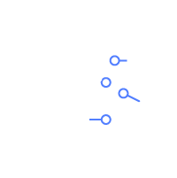







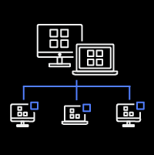
Amazon Comprehend
Discover insights and relationships in text
Entities
Key Phrases
+ Custom Entities
Language
PII
(Personally Identifiable Information)
Documents
Email, chat, social, phone calls and more
Amazon
Comprehend
Automatically extract insights from text
Sentiment
Syntax
Document Classification
Topics
Notes:
Amazon Comprehend has pre-trained models that identify entities such as places, people, brands, or events; determine the language of the text; extract key phrases; understand how positive or negative the sentiment of text is; and automatically organize a collection of text files by topic.
However, customers have data that contains text that is very specific to their organization or business. They could have specific product names or document types. Therefore customers can train Comprehend to extract customer-specific entities or to assign specific labels to documents.
Vision Critical provides a customer relationship intelligence software that enable large enterprises to be fast, responsive, and customer-centric. By integrating with Amazon Comprehend’s sentiment analysis, their platform turns qualitative customer feedback into actionable insight, determining whether their feedback is positive, negative, or neutral at over 90% accuracy.
LexisNexis uses Comprehend’s custom entities recognition models to discover insights from legal documents. Entities such as judge and attorney, can be identified quickly from over 200 million documents at above 92% accuracy.

Slide 30
Topic Modeling
Keywords Topic Groups
Document Relationship to Topics
Topic | Term | Weight
1 | Amazon | 0.87
1 | Seattle | 0.65
2 | Holidays | 0.78
2 | Shopping | 0.67
Document | Topic | Proportion
Doc1.txt | 1 | 0.87
Doc2.txt | 1 | 0.65
Doc3.txt | 2 | 0.78
Doc4.txt | 2 | 0.67
Notes:
Topic Modelling: You can use Amazon Comprehend to examine the content of a collection of documents to determine common themes. For example, you can give Amazon Comprehend a collection of news articles, and it will determine the subjects, such as sports, politics, or entertainment. The text in the documents doesn't need to be annotated.
https://aws.amazon.com/comprehend/features/#Topic_Modeling
If your documents (Doc1.txt, Doc2.txt, Doc3.txt, Doc4.txt) are stored in Amazon S3, and you point Amazon Comprend to their location, Comprehend will analyze the documents and return two views:
Grouping of keywords that are topics: Each group of keywords is associated with a topic group. Weight refers to the prevalence of that keyword within the group. Keywords with the weight closest to 1 are most indicative of the topic group’s context.
Grouping of documents by topics: Each document is mapped to a topic group based on the proportion of the topic group’s weighted keywords that are present in the document.
Customers can also use Amazon Comprehend to examine a corpus of documents to organize them based on similar keywords within them. Document clustering (topic modeling) is useful to organize a large corpus of documents into topics or clusters that are similar based on the frequency of words within them.
Topic modeling is a asynchronous process. Customers can submit a set of documents for processing and then later get the results when processing is complete.
Customers use topic modeling to surface common topics in large repositories of documents.

Slide 31
Text Analysis
Named Entities
Amazon.com: Organization
Seattle, WA : Location
July 5th,1994: Date
Jeff Bezos : Person
Keyphrases
Our customers
books
blenders
great prices
Sentiment
Positive
Language
English
Amazon.com, Inc. is located in Seattle, WA and was founded July 5th, 1994 by Jeff Bezos. Our customers love buying everything from books to blenders at great prices
Notes:
Amazon Comprehend can identify 9 entity types that include person, location, date, quantity, organization, commercial item, title, event, and other. It can detect dominant language from a list 100 languages. It currently supports pre-trained models natively in 12 languages.
Customers can choose to use Amazon Comprehend pre-trained (non-custom) APIs in synchronous and batch modes. Synchronous APIs have a smaller text limit in order to offer low latency SLAs. If customers have large amounts of data to process, they can store their documents in their S3 bucket and invoke batch APIs.
For example, a large fast food chain in the US uses these pretrained APIs in real time to process surveys and social media content to determine what people are saying about their food in various parts of the US. They use this analysis to feed back into their product improvement initiatives.

Slide 32
Amazon Comprehend
Entities
Discover insights and relationships in text
Key Phrases
Language
Sentiment
Amazon Comprehend
PARTS OF SPEECH
Syntax
Topic Modeling
Custom Classifier
Custom Entities
Notes:
Amazon Comprehend has pre-trained models that identify entities such as places, people, brands, or events; determine the language of the text; extract key phrases; understand how positive or negative the sentiment of text is; and automatically organize a collection of text files by topic.
However, customers have data that contains text that is very specific to their organization or business. They could have specific product names or document types. Therefore customers can train Comprehend to extract customer-specific entities or to assign specific labels to documents.
Key phrases: key phrases or talking points and a confidence score to support that this is a key phrase.
Topic Modelling: You can use Amazon Comprehend to examine the content of a collection of documents to determine common themes. For example, you can give Amazon Comprehend a collection of news articles, and it will determine the subjects, such as sports, politics, or entertainment. The text in the documents doesn't need to be annotated.
Vision Critical provides a customer relationship intelligence software that enable large enterprises to be fast, responsive, and customer-centric. By integrating with Amazon Comprehend’s sentiment analysis, their platform turns qualitative customer feedback into actionable insight, determining whether their feedback is positive, negative, or neutral at over 90% accuracy.
LexisNexis uses Comprehend’s custom entities recognition models to discover insights from legal documents. Entities such as judge and attorney, can be identified quickly from over 200 million documents at above 92% accuracy.

Slide 33
Amazon Comprehend
Discover insights and relationships in text
Entities
Key Phrases
+ Custom Entities
Language
PII
(Personally Identifiable Information)
Documents
Email, chat, social, phone calls and more
Amazon
Comprehend
Automatically extract insights from text
Sentiment
Syntax
Document Classification
Topics
Notes:
Amazon Comprehend has pre-trained models that identify entities such as places, people, brands, or events; determine the language of the text; extract key phrases; understand how positive or negative the sentiment of text is; and automatically organize a collection of text files by topic.
However, customers have data that contains text that is very specific to their organization or business. They could have specific product names or document types. Therefore customers can train Comprehend to extract customer-specific entities or to assign specific labels to documents.
Vision Critical provides a customer relationship intelligence software that enable large enterprises to be fast, responsive, and customer-centric. By integrating with Amazon Comprehend’s sentiment analysis, their platform turns qualitative customer feedback into actionable insight, determining whether their feedback is positive, negative, or neutral at over 90% accuracy.
LexisNexis uses Comprehend’s custom entities recognition models to discover insights from legal documents. Entities such as judge and attorney, can be identified quickly from over 200 million documents at above 92% accuracy.

Slide 34
Custom Comprehend

Slide 35
Custom Classification: Multi-class
Classes are mutually exclusive
Text categorized into one class
Each model allows 1000 classes
Classification: “PRICING_QUERY”
Support tickets
Chat forum messages
Customer feedback
Support calls
Classification: “TECH_SUPPORT”
Example
Classification: “FEEDBACK”
For each class, minimum of 10 documents required for training. For more accurate training, at least 50 documents or more for each class recommended.
Notes:
Customers use Custom Classification for use cases such as - automatically routing support tickets to teams who can resolve them faster, categorizing emails into support requests and sales orders, and separating out customer feedback by different products.
Customers can train two types of classifiers. Using a multi-class classifier, text can be categorized into one of many mutually exclusive classes. With multi-label classifier, multiple labels can be associated with the same text.
A single multi-class classifier model can categorize text into 1000 classes.
What makes Comprehend custom classifier easy to adopt is that customers can train a model by providing as little as 50 examples of each class. We have business users who have used AWS Management Console to train custom classifiers and run inference jobs without any help from any developer or data scientist.
Customers use custom classifier in production for large classification use cases. A global consumer durables manufacturer analyzes description text for thousands of videos to categorize videos into about 3000 categories using a series of custom classifier models trained in Comprehend. Customers also use classification to identify document types to determine what entities they might contain and extract them using entity recognition.

Slide 36
Custom Classification: Multi-label
Classes are not mutually exclusive
Text categorized into one or more classes
Each model allows 100 unique classes
Classification: “Horror”
Classification:
“Adventure”, ”Comedy”
Example
Movie descriptions
Classification: “Romance”, “Drama”
For each class, minimum of 10 documents required for training. For more accurate training, at least 50 documents or more for each class recommended.
Notes:
Customers can also train multi-label classifier models to associate multiple labels to the same text. Use cases such as associating an incoming email with multiple products OR associating different genre to a movie would be best done by this type of classifier model. Each multi-label model allows 100 unique classes.

Slide 37
Automated Custom Classifier Training
1
Create a CSV file with training data
2
Train the service
3
Classify
LABEL | TEXT
FEEDBACK | The service is very expensive compared to competition
TECH_SUPPORT | I am not able to access the transactions page
PRICING_QUERY | Is there any volume discount on the product?
FEEDBACK | It took two days to resolve the issue. I am frustrated.
PRICING_QUERY | How much would it cost to use this service?
Automated algorithm selection
Automated tuning and testing
SDK or code-free Console UX
Notes:
Training a custom classifier is easy. Customers simply need to create a CSV (comma separated values) file with two columns. The first column should contain labels with respective example training text in the second column as shown here. Customers then need to place the CSV file in an S3 bucket and start a classifier training job after providing some simple parameter values. The training job returns accuracy metrics that tell how well the classifier model was trained. Customers can compare actual labels provided by a human versus labels predicted by Comprehend to determine model accuracy. This also tells a user what classes may require additional training data.
Comprehend uses multiple algorithms in the training process and picks the combination that delivers highest accuracy. This way, users need not deal with complexities of choosing different algorithms, running iterations, and determining the best ensemble of algorithms. They simply need to provide training text and Comprehend does the rest.
Once a model is trained, users can reference it by name and run inference jobs either synchronously or asynchronously.

Slide 38
Real-time Analysis with Synchronous Custom Classification
Synchronous API to use custom classifier with Comprehend
Endpoint based
Autoscales to manage volume
Pricing based on endpoint uptime
Notes:
Synchronous classifier was launched in December 2019 for customers who need to run custom classification inference jobs in real time. They may want to do so to categorize incoming chat messages while a customer is waiting. Customers with business process with stringent email response SLAs also prefer to use synchronous custom classification.
Its important to note that the method of creating classifiers remains the same in both synchronous and asynchronous consumption methods. Synchronous classifiers need a user to create an endpoint before they can make real time inferences with their custom models. This endpoint is dedicated to the users custom model and is charged to them on endpoint size and for the duration they are on. The size of an endpoint is based on the amount of data it can process per second starting with 100 characters per second. These endpoints can auto-scale based on the volume of incoming data.

Slide 39
Amazon Comprehend
Entities
Discover insights and relationships in text
Key Phrases
Language
Sentiment
Amazon Comprehend
PARTS OF SPEECH
Syntax
Topic Modeling
Custom Classifier
Custom Entities
Notes:
Comprehend can be trained to work with organization’s specific data that Comprehend has not processed before. Customers can train Comprehend to assign labels to text and to extract custom entities in addition to the 9 entity types detected by pre-trained model.
COMMERCIAL_ITEM, DATE, EVENT, LOCATION, ORGANIZATION, OTHER, PERSON, QUANTITY, TITLE.
https://docs.aws.amazon.com/comprehend/latest/dg/how-entities.html
https://techcrunch.com/2018/11/19/amazon-comprehend-adds-customized-language-lists-to-machine-learning-tool/

Slide 40
Amazon Comprehend
Discover insights and relationships in text
Entities
Key Phrases
+ Custom Entities
Language
PII
(Personally Identifiable Information)
Documents
Email, chat, social, phone calls and more
Amazon
Comprehend
Automatically extract insights from text
Sentiment
Syntax
Document Classification
Topics
Notes:
Amazon Comprehend has pre-trained models that identify entities such as places, people, brands, or events; determine the language of the text; extract key phrases; understand how positive or negative the sentiment of text is; and automatically organize a collection of text files by topic.
However, customers have data that contains text that is very specific to their organization or business. They could have specific product names or document types. Therefore customers can train Comprehend to extract customer-specific entities or to assign specific labels to documents.
Vision Critical provides a customer relationship intelligence software that enable large enterprises to be fast, responsive, and customer-centric. By integrating with Amazon Comprehend’s sentiment analysis, their platform turns qualitative customer feedback into actionable insight, determining whether their feedback is positive, negative, or neutral at over 90% accuracy.
LexisNexis uses Comprehend’s custom entities recognition models to discover insights from legal documents. Entities such as judge and attorney, can be identified quickly from over 200 million documents at above 92% accuracy.

Slide 41
Custom Entities
Analyze documents for your business and domain terms and phrases
Bring your own schema to unstructured text analytics
Hello, my name is John Doe, and thank you for calling AnyCompany. I understand you are calling about part number XT2457. We have that part on back order and we are expediting it for you.
Thank you, but I was expediting it last week. At this point I think we should go ahead and cancel the order entirely.
We are sorry to hear that sir, would you be willing to complete the order if we offered a 10% discount?
Yes, thank you.
Organization: AnyCompany
Person: John Doe
Part: XT2457
Action: cancel the order
Notes:
Custom entity recognition extends the capability of Amazon Comprehend by enabling you to identify new entity types not supported as one of the preset generic entity types. This means that in addition to identifying entity types such as LOCATION, DATE, PERSON, and so on, you can analyze documents and extract entities like product codes or business-specific entities that fit your particular needs.
Customers who would like to extract entities that are not detected by the pre-trained entity detection API can do so with custom entity detection API. Customers use this API in a number of interesting use cases such as
Automated extraction of data from emails
Extraction of data from financial documents such as insurance contracts, mortgage documents, county records
Processing of legal documents to extract legal data from contracts
Extraction of PII (Personally Identifiable Information) and downstream redaction

Slide 42
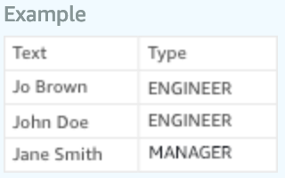
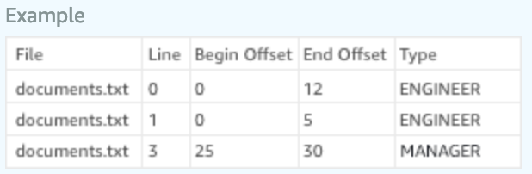
Training data for Custom Entity Recognizer Training
Using entity list and training docs
Using annotations and training docs
1
OR
2
Simple and fast
Specify entity values that are present in the training documents
May have poor accuracy if different entity types have same values or values in wrong context are selected for training
Specify document offset for values present in the training documents
Higher annotation effort
Higher accuracy as only specific values in the desired context are selected for training
Notes:
Insurance or legal for example can have different kinds of entities
Want to train these models for their specific entities types.
If you don’t have this service and want to build something from scratch, you need to learn machine learning, learn NLP,… it can take a lot of time.
Customers can just give us examples of entities they want to see from the text and show us how the entities are used in the context of their documents and that’s it. You put that in a CSV file.
The service automatically look at the data, picks the right algorithm, self-tune itself to get the highest level of accuracy and then the model can be used by the customer.
Just like training a classifier, training a custom entity recognizer requires a CSV file that provides annotated training data.
Again, with the intent of making it easy for a developer to use the service, Comprehend simplifies custom entity recognizer training. There are two ways to create training data.
Entity List: This is an easy and fast way of training Comprehend ER. Customers simply create a CSV file with two columns. The first one contains the actual value of an entity type that exists in training documents. The second column contains the respective entity type. Customers then upload their example training documents in an S3 bucket and start a training job. Comprehend then picks up the values in the CSV file, locates them in the training documents in S3 bucket and trains on the context of the entity types. While this process is easy, sometimes it leads to accuracy issues if the values provided for one entity type exists for another entity type as well. Therefore, Comprehend offers another way of preparing training data that is more accurate.
The other way of training is using Annotations. In this approach, a user does not provide the actual entity values but specifies the actual offset of example entity values in training documents. This is done by specifying the line number, starting point, and ending point for example entity types in the training documents. So if there are two people with the same name John Doe – one an engineer and another a manager, a user can now specify who is who in their annotation file. The rest of the training process is the same as entity list approach.
This technical nuance is important as it has been found to create accuracy issues for customers who choose to train a model using entity list, not realizing their data was not suited for this approach.

Slide 43
Automated Custom Entity Recognizer Training
1
Prepare examples
2
Train the service
3
Analyze
Entity List
Hello, my name is John Doe, and thank you for calling AnyCompany. I understand you are calling about part number XT2457. We have that part on back order and we are expediting it for you.
Thank you, but I was expediting it last week. At this point I think we should go ahead and cancel the order entirely.
We are sorry to hear that sir, would you be willing to complete the order if we offered a 10% discount?
Yes, thank you.
ENTITY VALUE | ENTITY TYPE
XT2457 | PART
Renew Subscription | ACTION
SD5578 | PART
Cancel the order | ACTION
Automated annotation
Automated algorithm selection
Automated tuning and testing
SDK or code-free Console UX
+
Documents containing terms and phrases in text
Recommend 200 examples per entity type
Notes:
Each custom entity recognizer model supports 12 entity types. It is recommended that users provide 200 examples of each entity type when training custom ER.
Once a model is trained, users can reference it by name and run inference jobs either asynchronously.
Custom entity recognition does not support synchronous API at the moment.
Customers can train custom Comprehend models using AWS Management Console, using CLI, or SDK.

Slide 44
Amazon Comprehend – Languages Supported
Languages | Detect Entities, Key Phrases, Sentiment Analysis | Analyze Syntax | Custom Classifier | Custom Entity Recognition
English (en) | ✓ | ✓ | ✓ | ✓
Spanish (es) | ✓ | ✓ | ✓ | ✓
French (fr) | ✓ | ✓ | ✓ | ✓
German (de) | ✓ | ✓ | ✓ | ✓
Italian (it) | ✓ | ✓ | ✓ | ✓
Portuguese (pt) | ✓ | ✓ | ✓ | ✓
Arabic (ar) | ✓
Chinese - traditional (zh-TW) | ✓
Chinese – simplified (zh) | ✓
Hindi (hi) | ✓
Japanese (ja) | ✓
Korean (ko) | ✓
https://docs.aws.amazon.com/comprehend/latest/dg/supported-languages.html
Notes:
Comprehend supports entity detection, key phrase detection, and sentiment analysis natively in 12 languages listed here. It supports custom classification in English, Spanish, French, German, Italian, and Portuguese. Custom Entity Recognition is currently supported in English only.
Customers who need to analyze text in languages not supported by Comprehend can leverage Amazon Translate to convert text into supported langauge before processing with Comprehend.

Slide 45

Discover insights from legal documents
“We provide legal professionals with insightful research and analytics to help them make informed decisions. Therefore, we are always looking for better ways to discover insights from legal documents. Thanks to Amazon Comprehend's automatic machine learning (ML), we can now build accurate custom entity recognition models without getting into the complexities associated with ML. The entities that we care about the most, such as judge and attorney, can be identified quickly from over 200 million documents at above 92% accuracy.”
– Rick McFarland, Chief Data Officer of LexisNexis
Notes:
https://aws.amazon.com/comprehend/customers/
LexisNexis uses Comprehend’s custom entities recognition models to discover insights from legal documents. Entities such as judge and attorney, can be identified quickly from over 200 million documents at above 92% accuracy.
LexisNexis Legal & Professional is a global provider of content and technology solutions for legal and business professionals, serving customers in more than 175 countries, offering over 2 billion searchable archives.
LexisNexis is the world’s leading legal service company. It is doing NLP for more than a decade. They have seen higher quality with Custom Comprehend
LexisNexis is the world’s largest legal service company, they have millions of customers. They ingest a ton of data a day. Everyday, they go get every court case file across the United States and other jurisdiction and they just run the whole think though Giant and NLP service.
They can do things like: Hey, when this court case happened in this region, who represented it? Who is the judge? What is the outcome?
If you are a lawyer and you are about to take a case like this. You would like to ask: Hey, LexisNexis, what was the outcome about these cases, what was the ruling, what can I learn from that?
They go over the data and they run a pretty robust pipeline.

Slide 46


Acting on customer feedback
Bark & Co uses Amazon Comprehend to analyze their customers’ comments and feedback, allowing them to respond faster and improve the customer experience.
Notes:
Bark & Co is the parent company for BarkShop, an ecommerce site for dog treats and products, and BarkBox, a monthly pet subscription box.
Their engineering team wanted to ensure colleagues were correctly understanding the sentiment of their customers’ comments and feedback.
To do this, the company started using AWS Comprehend to analyze the custom, text-written responses they were receiving and were consequently able to better gauge what their pet-loving base was trying to say.
This has allowed them to respond faster to customer requests and feedback, improving the customer experience.

Slide 47








Typical Amazon Comprehend use cases
Automation of email workflows
Customer sentiment analysis
Customer support tickets routing
Contact center call analysis
Personally Identifiable Information (PII) detection and redaction
Documents and media tagging
Document data extraction

Slide 48
The AWS ML Stack Broadest and most complete set of machine learning capabilities
AI SERVICES
HEALTH AI
INDUSTRIAL AI
ANOMALY DETECTION
CODE AND DEVOPS
NEW
Amazon HealthLake
Amazon Transcribe for Medical
Amazon Comprehend for Medical
NEW
AWS Panorama + Appliance
NEW
Amazon Monitron
NEW
Amazon Lookout for Equipment
NEW
Amazon Lookout for Vision
NEW
Amazon Lookout for Metrics
NEW
Amazon DevOps Guru
Amazon CodeGuru
 | VISION | SPEECH | TEXT | SEARCH | CHATBOTS | PERSONALIZATION | FORECASTING | FRAUD | CONTACT CENTERS
Amazon Rekognition
Amazon Polly
Amazon Transcribe
+Medical
Amazon Comprehend
+Medical
Amazon Translate
Amazon Textract
Amazon Kendra
Amazon Lex
Amazon Personalize
Amazon Forecast
Contact Lens
Amazon Fraud Detector
Voice ID
For Amazon Connect
ML SERVICES
SAGEMAKER STUDIO IDE
Label data | NEW Aggregate & prepare data | NEW Store & share features | Auto ML | Spark/R | NEW Detect bias | Visualize in notebooks | Pick algorithm | Train models | Tune parameters | NEW Debug & profile | Deploy in production | Manage & monitor | NEW CI/CD | Human review
Amazon SageMaker
NEW: SageMaker JumpStart
NEW: Model management for edge devices
FRAMEWORKS & INFRASTRUCTURE
Deep Learning AMIs & Containers | GPUs & CPUs | Elastic Inference | Trainium | Inferentia | FPGA
DeepGraphLibrary
Notes:
Speaker Notes
1/ As you know, AWS offers builders with the right tools for the right job and provides them their choice of tools.
2/ When it comes to AI & Machine Learning, AWS offers a broad and deep set of services and supporting cloud infrastructure so that we can put machine learning in the hands of every developer, data scientist and expert practitioner.
3/ SageMaker is the middle of our 3-tier stack, and is intended for anyone who is looking to build, train, and deploy their own custom machine learning models.
Speaker Guidance
This slide should be presented quickly. By the time you are delivering this presentation to your audience, you should know that they want to specifically dive deep into SageMaker.

Slide 49
Amazon Translate
New supported languages
All 24 EU languages supported except Irish
https://docs.aws.amazon.com/translate/latest/dg/what-is.html

Slide 50
The AWS ML Stack Broadest and most complete set of machine learning capabilities
AI SERVICES
HEALTH AI
INDUSTRIAL AI
ANOMALY DETECTION
CODE AND DEVOPS
NEW
Amazon HealthLake
Amazon Transcribe for Medical
Amazon Comprehend for Medical
NEW
AWS Panorama + Appliance
NEW
Amazon Monitron
NEW
Amazon Lookout for Equipment
NEW
Amazon Lookout for Vision
NEW
Amazon Lookout for Metrics
NEW
Amazon DevOps Guru
Amazon CodeGuru
 | VISION | SPEECH | TEXT | SEARCH | CHATBOTS | PERSONALIZATION | FORECASTING | FRAUD | CONTACT CENTERS
Amazon Rekognition
Amazon Polly
Amazon Transcribe
+Medical
Amazon Comprehend
+Medical
Amazon Translate
Amazon Textract
Amazon Kendra
Amazon Lex
Amazon Personalize
Amazon Forecast
Contact Lens
Amazon Fraud Detector
Voice ID
For Amazon Connect
ML SERVICES
SAGEMAKER STUDIO IDE
Label data | NEW Aggregate & prepare data | NEW Store & share features | Auto ML | Spark/R | NEW Detect bias | Visualize in notebooks | Pick algorithm | Train models | Tune parameters | NEW Debug & profile | Deploy in production | Manage & monitor | NEW CI/CD | Human review
Amazon SageMaker
NEW: SageMaker JumpStart
NEW: Model management for edge devices
FRAMEWORKS & INFRASTRUCTURE
Deep Learning AMIs & Containers | GPUs & CPUs | Elastic Inference | Trainium | Inferentia | FPGA
DeepGraphLibrary
Notes:
Speaker Notes
1/ As you know, AWS offers builders with the right tools for the right job and provides them their choice of tools.
2/ When it comes to AI & Machine Learning, AWS offers a broad and deep set of services and supporting cloud infrastructure so that we can put machine learning in the hands of every developer, data scientist and expert practitioner.
3/ SageMaker is the middle of our 3-tier stack, and is intended for anyone who is looking to build, train, and deploy their own custom machine learning models.
Speaker Guidance
This slide should be presented quickly. By the time you are delivering this presentation to your audience, you should know that they want to specifically dive deep into SageMaker.

Slide 51

Enterprise Search
→ Still a challenge today
Notes:
All of the documents that are not searchable at the moment in your corporate environment.
Wikis, different documents, emails and archives.

Slide 52
Employees spend 20% of their time looking for information. —McKinsey
20%
44% of the time, they cannot find the information they need to do their job.
—IDC
44%

Slide 53
Key challenges
Low Accuracy
80% of data is unstructured
Keyword Engines
Complexity
Scattered Data Silos
Stale Search Results
Difficult to set up
Notes:
80%+ of enterprise data is unstructured.
Low accuracy: Difficult to find accurate answers in unstructured data.
Keyword engines
Stale Search Results: Deploying a search engine that can learn and improve its models based on customer specific data is a difficult task to undertake for any enterprise.
Scattered data silos: Vast amounts of text stored in many formats and spread across disjointed data sources, onsite and in the cloud. difficult to setup, because each silo has its own indexing and data format
Complex implementations.

Slide 54
Impact on the enterprise
Lower employee productivity
Increased risk and liability
Duplication of work
Creates negative customer experience
Notes:
More time searching than working
Not being able to find the right information can also increase the risk and liability
Ex: call center

Slide 55
Rethinking Enterprise Search
Notes:
Amazon Kendra is an enterprise search engine

Slide 56



Amazon Kendra Rethinking enterprise search for everyone
Natural language
Queries
NLU and ML core
Domain Expertise
Continuous Improvement
Simple API
and console experiences
Code samples
Native connectors
Easy to find what you are looking for
Simple and quick to set up
Notes:
Kendra addresses the three most critical challenges of enterprise search today:
easy to implement
Setup is entirely through the console
Connectors eliminate integration efforts, just provide credentials and it will create a consolidated index. No more information silos.
Kendra also indexes FAQs separately.
Then, just sync and index!
highly accurate – It doesn’t just index. Kendra uses ML and NLU to identify the concepts (like time, people and places) and relationships between documents. Kendra pulls all that data in, understands the concepts and relationships within the data and builds an index that can answer questions. Unlike the world wide web, where you can rely on the structure of HTML and links between documents, that structure doesn’t exist in the enterprise
continuously improving - And that index can be set to refresh at regular intervals

Slide 57
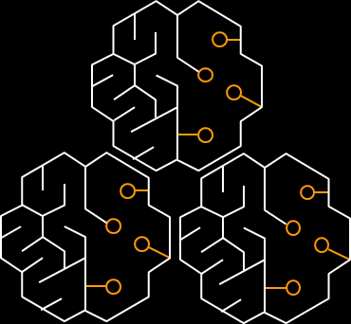

Amazon Kendra
Rethinking enterprise search for everyone
Natural language
Queries
Simple experiences and
Code samples
NLU and ML core
Domain Expertise
Continuous Improvement
Native connectors
Natural language queries
“Where is the IT support desk in Kumo?” → “1st floor”
Keyword queries
“Health benefits” or “parking allowance”
Better answers
Reading Comprehension
FAQ matching
Document ranking
Optimized for 16 major domains
IT, Financial Services, Insurance, Pharma, Industrial, Energy, Legal, Media and Entertainment, Travel and Hospitality, Health, HR, News, Telecommunications, Mining, Food and Beverages, and Automotive
Kendra improves automatically over time
Captures click-through and user feedback
Retrains models periodically
17 of the most popular and counting
S3, file systems (SMB), Web crawler, Databases, SharePoint Online, SharePoint on prem, Box, Dropbox, Exchange, OneDrive, Google Drive, Salesforce, Confluence, Jira, Servicenow, Zendesk, and Jive.
In-Console Search
Test your queries
Tune your relevance
Code Samples Provided
Replicate Kendra search components in your application
Notes:
Natural language, more intuitive
Factoid (who, what, when, where) will return an answer or highlight the interesting part of annswer
Descriptive (How do I connect my Echo Plus to my network?)
Keywords based
Query auto-completion ^{coming soon} , reduces the search time (25%), guide to more precise an already asked questions
So to dive little into the core capabilities that address “accuracy”, Kendra provides a more intuitive way to search your data. Natural language questions provide more clarity and more precise answers. Keyword search are supported as well of course.
Factoid, descriptive, keyword based
Natural language & keyword support
Amazon Kendra's ability to understand natural language questions is at the core of its search engine, so end users have the ability to search for general keywords like "health benefits" or more specific natural language questions like "how long is maternity leave?”. Kendra will return specific answers like "14 weeks", or for the more general searches Kendra will return the most relevant passage and related documents. Natural language enables you to get more specific answers from anywhere in your data.
Query auto-completion ^{coming soon}
Amazon Kendra includes the functionality to auto-complete an end user’s search query. Query auto-completion not only helps the user reduce typing by about 25%, it also helps them by guiding them towards more precise and commonly asked questions. More precise questions typically result in more relevant and useful answers. For example, if you start typing "Where is" in the search box, Kendra can suggest options like "Where is the IT desk?", or "Where is the cafeteria?" and other related commonly asked questions, to complete the query.

Slide 58
Amazon Kendra
Rethinking enterprise search for everyone
Natural language
Queries
Simple experiences and
Code samples
NLU and ML core
Domain Expertise
Continuous Improvement
Native connectors
Natural language queries
“Where is the IT support desk in Kumo?” → “1st floor”
Keyword queries
“Health benefits” or “parking allowance”
Better answers
Reading Comprehension
FAQ matching
Document ranking
Optimized for 16 major domains
IT, Financial Services, Insurance, Pharma, Industrial, Energy, Legal, Media and Entertainment, Travel and Hospitality, Health, HR, News, Telecommunications, Mining, Food and Beverages, and Automotive
Kendra improves automatically over time
Captures click-through and user feedback
Retrains models periodically
17 of the most popular and counting
S3, file systems (SMB), Web crawler, Databases, SharePoint Online, SharePoint on prem, Box, Dropbox, Exchange, OneDrive, Google Drive, Salesforce, Confluence, Jira, Servicenow, Zendesk, and Jive.
In-Console Search
Test your queries
Tune your relevance
Code Samples Provided
Replicate Kendra search components in your application
Notes:
Better enterprise search is about providing better answers. To deliver this, Kendra uses three core components to find the best answers in your data.
Data supported: unstructured and semi-structured data in .html, MS Office (.doc, .ppt), PDF, and text formats.
Reading comprehension: the answer is automatically extracted from the most relevant document
FAQ matching: upload a list of FAQs to Kendra to provide direct answers to common questions your end users are asking. Kendra will find the closest question to the search query and return the corresponding answer.
Document ranking: to complement the extracted answers, Amazon Kendra uses a deep learning based semantic search model to return a ranked list of relevant documents. This provides the end user a more exhaustive list of content to explore should they need more information.
Reading comprehension & FAQ matching
Amazon Kendra can extract specific answers from unstructured data. No pre-training is required, you simply point Kendra at your content and Kendra will provide specific answers to natural language queries like "how do I configure my VPN?" where the answer is automatically extracted from the most relevant document. You can also upload a list of FAQs to Kendra to provide direct answers to common questions your end users are asking. Kendra will find the closest question to the search query and return the corresponding answer.
Document ranking
To complement the extracted answers, Amazon Kendra uses a deep learning based semantic search model to return a ranked list of relevant documents. This provides the end user a more exhaustive list of content to explore should they need more information.

Slide 59
Amazon Kendra
Rethinking enterprise search for everyone
Natural language
Queries
Simple experiences and
Code samples
NLU and ML core
Domain Expertise
Continuous Improvement
Native connectors
Natural language queries
“Where is the IT support desk in Kumo?” → “1st floor”
Keyword queries
“Health benefits” or “parking allowance”
Better answers
Reading Comprehension
FAQ matching
Document ranking
Optimized for 16 major domains
IT, Financial Services, Insurance, Pharma, Industrial, Energy, Legal, Media and Entertainment, Travel and Hospitality, Health, HR, News, Telecommunications, Mining, Food and Beverages, and Automotive
Kendra improves automatically over time
Captures click-through and user feedback
Retrains models periodically
17 of the most popular and counting
S3, file systems (SMB), Web crawler, Databases, SharePoint Online, SharePoint on prem, Box, Dropbox, Exchange, OneDrive, Google Drive, Salesforce, Confluence, Jira, Servicenow, Zendesk, and Jive.
In-Console Search
Test your queries
Tune your relevance
Code Samples Provided
Replicate Kendra search components in your application
Notes:
You can further fine tune and extend Kendra's domain-specific understanding by providing your own synonym lists (coming soon). You just upload a file with your specific terminology and Kendra will use these synonyms to enrich user searches.
Kendra offers domain specific expertise for
IT
Financial services
Insurance
Pharmaceuticals
Industrial manufacturing
Energy
Legal
Media and entertainment
Travel and hospitality
Health
Human resources
News
Telecommunications
Mining
Food and Beverage
Automotive
You can further fine tune and extend Kendra's domain-specific understanding by providing your own synonym lists (coming soon). You just upload a file with your specific terminology and Kendra will use these synonyms to enrich user searches.

Slide 60
Amazon Kendra
Rethinking enterprise search for everyone
Natural language
Queries
Simple experiences and
Code samples
NLU and ML core
Domain Expertise
Continuous Improvement
Native connectors
Natural language queries
“Where is the IT support desk in Kumo?” → “1st floor”
Keyword queries
“Health benefits” or “parking allowance”
Better answers
Reading Comprehension
FAQ matching
Document ranking
Optimized for 16 major domains
IT, Financial Services, Insurance, Pharma, Industrial, Energy, Legal, Media and Entertainment, Travel and Hospitality, Health, HR, News, Telecommunications, Mining, Food and Beverages, and Automotive
Kendra improves automatically over time
Captures click-through and user feedback
Retrains models periodically
17 of the most popular and counting
S3, file systems (SMB), Web crawler, Databases, SharePoint Online, SharePoint on prem, Box, Dropbox, Exchange, OneDrive, Google Drive, Salesforce, Confluence, Jira, Servicenow, Zendesk, and Jive.
In-Console Search
Test your queries
Tune your relevance
Code Samples Provided
Replicate Kendra search components in your application
Notes:
Incremental learning^{coming soon}: Kendra can learn how to prioritize certain documents based on the interest.
Analytics and ongoing improvement^{coming soon}:
Amazon Kendra captures the activities during searches (clicks, thumbs up or down) and will surface metrics and insights to you so that you can take action to make improvements. Kendra provides basic operational metrics like top queries, top documents, and queries per day. Kendra will also provide common quality metrics such as Mean Reciprocal Rank (MRR) and explicit feedback, i.e. thumbs up or down counts.
You can use this information to create more relevant FAQs, boost certain data sources with more authoritative content, or train your customer support teams on commonly asked questions.
Incremental learning ^{coming soon}
Amazon Kendra's machine learning models are regularly retrained and tuned for each customer by capturing end-user search patterns and feedback. For example, when users search for “How do I change my health benefits?", multiple HR and benefit documents will compete for a top spot. Although more recent documents can be ranked higher in the list, this criteria alone might not be sufficient to win the top spot on the list. However, as interest grows for the latest year’s enrollment instructions and users start opening it more than the older ones, the Kendra model will learn to increasingly prioritize the new document towards the top of the list.
Analytics and ongoing improvement ^{coming soon}
In order to provide a continuously improving search experience, Amazon Kendra captures the activities during searches (clicks, thumbs up or down) and will surface metrics and insights to you so that you can take action to make improvements. Kendra provides basic operational metrics like top queries, top documents, and queries per day. Kendra will also provide common quality metrics such as Mean Reciprocal Rank (MRR) and explicit feedback, i.e. thumbs up or down counts. You can use this information to create more relevant FAQs, boost certain data sources with more authoritative content, or train your customer support teams on commonly asked questions.

Slide 61
Amazon Kendra
Incremental learning
Notes:
Continuous Improvement and incremental learning. Kendra improves automatically over time:
Captures click-through and user feedback
Retrains models periodically

Slide 62
Amazon Kendra
Rethinking enterprise search for everyone
Natural language
Queries
Simple experiences and
Code samples
NLU and ML core
Domain Expertise
Continuous Improvement
Native connectors
Natural language queries
“Where is the IT support desk in Kumo?” → “1st floor”
Keyword queries
“Health benefits” or “parking allowance”
Better answers
Reading Comprehension
FAQ matching
Document ranking
Optimized for 16 major domains
IT, Financial Services, Insurance, Pharma, Industrial, Energy, Legal, Media and Entertainment, Travel and Hospitality, Health, HR, News, Telecommunications, Mining, Food and Beverages, and Automotive
Kendra improves automatically over time
Captures click-through and user feedback
Retrains models periodically
17 of the most popular and counting
S3, file systems (SMB), Web crawler, Databases, SharePoint Online, SharePoint on prem, Box, Dropbox, Exchange, OneDrive, Google Drive, Salesforce, Confluence, Jira, Servicenow, Zendesk, and Jive.
In-Console Search
Test your queries
Tune your relevance
Code Samples Provided
Replicate Kendra search components in your application

Slide 63
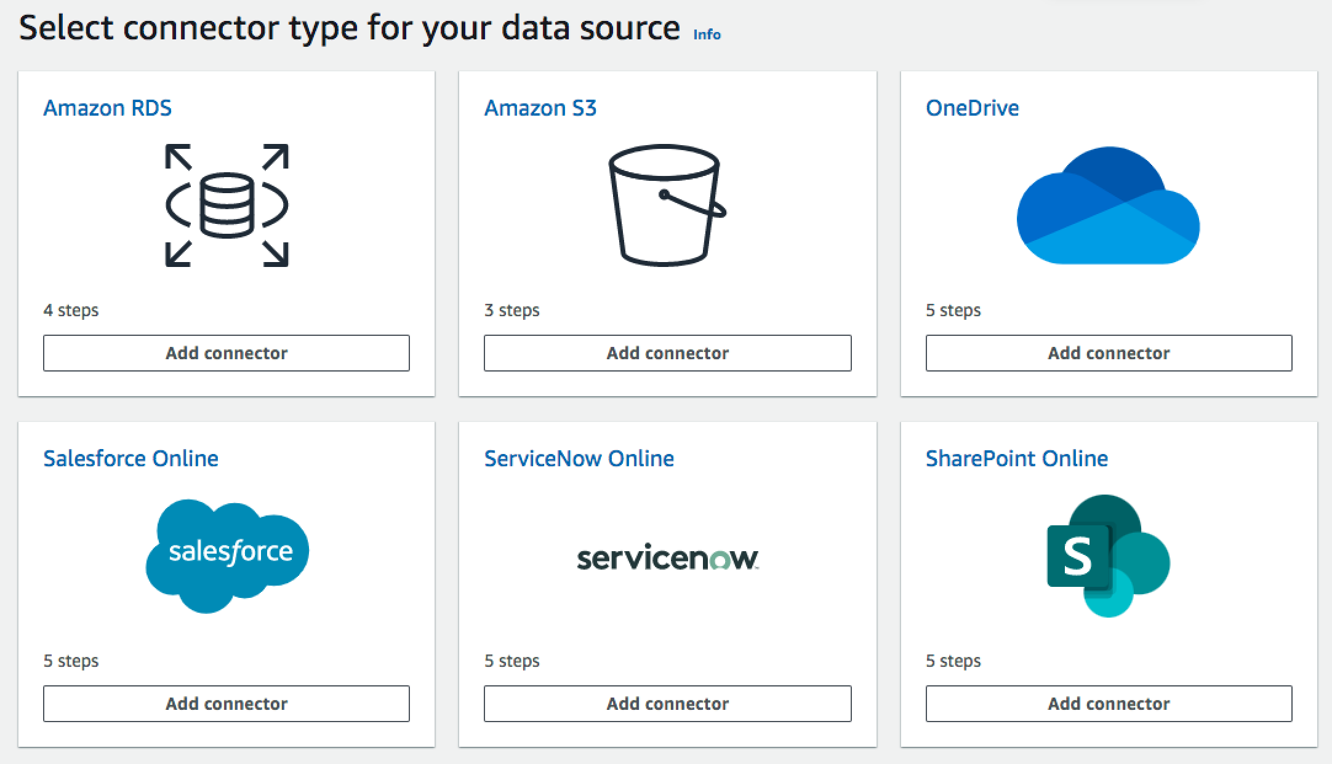
Amazon Kendra
Connector Library
https://aws.amazon.com/kendra/connectors/
Notes:
Using connectors is quick and easy, you just add data sources to your Kendra index and select the connector type. Connectors will maintain document access rights and can be scheduled to automatically sync your index with your data source, so you're always securely searching through the most up to date content.

Slide 64




Kendra Supported Connectors
Amazon S3
File systems (SMB)
Web crawler
Databases
Sharepoint Online
Sharepoint 2013, 2016, 2019
Box
Dropbox
Exchange
OneDrive
Google Drive
Salesforce
Confluence
Jira
Servicenow Online
Zendesk
Jive
…and more coming in 2020
Notes:
Yellow highlighted – available in preview
Green highlighted – available by GA
Non highlighted – available later in 2020. More to be announced as well

Slide 65
Amazon Kendra
Rethinking enterprise search for everyone
Natural language
Queries
Simple experiences and
Code samples
NLU and ML core
Domain Expertise
Continuous Improvement
Native connectors
Natural language queries
“Where is the IT support desk in Kumo?” → “1st floor”
Keyword queries
“Health benefits” or “parking allowance”
Better answers
Reading Comprehension
FAQ matching
Document ranking
Optimized for 16 major domains
IT, Financial Services, Insurance, Pharma, Industrial, Energy, Legal, Media and Entertainment, Travel and Hospitality, Health, HR, News, Telecommunications, Mining, Food and Beverages, and Automotive
Kendra improves automatically over time
Captures click-through and user feedback
Retrains models periodically
17 of the most popular and counting
S3, file systems (SMB), Web crawler, Databases, SharePoint Online, SharePoint on prem, Box, Dropbox, Exchange, OneDrive, Google Drive, Salesforce, Confluence, Jira, Servicenow, Zendesk, and Jive.
In-Console Search
Test your queries
Tune your relevance
Code Samples Provided
Replicate Kendra search components in your application
Notes:
Relevance tuning
You can boost certain fields in your index in order to assign more importance to specific responses. Amazon Kendra allows you to tune for specific data sources or document freshness. For example, when searching for “When is re:invent?” you can boost the relevance of document freshness so that the 2019 dates are the suggested answer. Or, you could boost a more reputable data source in an index of research reports. Kendra also supports boosting documents based on a vote or view count, which is common in forums and other support type knowledge bases. Combining these boosting features would, for example, boost documents that are not only viewed more often but that are also more recent, like trending news or updates.

Slide 66
Amazon Kendra
Custom Synonyms
Notes:
Synonyms can be useful in the following scenarios:
Specialized terms that are not traditional English language synonyms such as NLP, Natural Language Processing.
Proper nouns with complex semantic associations. These are nouns that the general public are unlikely to understand, for example, in machine learning, cost, loss, model performance.
Different forms of product names, for example, Elastic Compute Cloud, EC2.
Domain-specific concept terms for product names, for example, Route53, DNS.

Slide 67
The AWS ML Stack Broadest and most complete set of machine learning capabilities
AI SERVICES
HEALTH AI
INDUSTRIAL AI
ANOMALY DETECTION
CODE AND DEVOPS
NEW
Amazon HealthLake
Amazon Transcribe for Medical
Amazon Comprehend for Medical
NEW
AWS Panorama + Appliance
NEW
Amazon Monitron
NEW
Amazon Lookout for Equipment
NEW
Amazon Lookout for Vision
NEW
Amazon Lookout for Metrics
NEW
Amazon DevOps Guru
Amazon CodeGuru
 | VISION | SPEECH | TEXT | SEARCH | CHATBOTS | PERSONALIZATION | FORECASTING | FRAUD | CONTACT CENTERS
Amazon Rekognition
Amazon Polly
Amazon Transcribe
+Medical
Amazon Comprehend
+Medical
Amazon Translate
Amazon Textract
Amazon Kendra
Amazon Lex
Amazon Personalize
Amazon Forecast
Contact Lens
Amazon Fraud Detector
Voice ID
For Amazon Connect
ML SERVICES
SAGEMAKER STUDIO IDE
Label data | NEW Aggregate & prepare data | NEW Store & share features | Auto ML | Spark/R | NEW Detect bias | Visualize in notebooks | Pick algorithm | Train models | Tune parameters | NEW Debug & profile | Deploy in production | Manage & monitor | NEW CI/CD | Human review
Amazon SageMaker
NEW: SageMaker JumpStart
NEW: Model management for edge devices
FRAMEWORKS & INFRASTRUCTURE
Deep Learning AMIs & Containers | GPUs & CPUs | Elastic Inference | Trainium | Inferentia | FPGA
DeepGraphLibrary
Notes:
Speaker Notes
1/ As you know, AWS offers builders with the right tools for the right job and provides them their choice of tools.
2/ When it comes to AI & Machine Learning, AWS offers a broad and deep set of services and supporting cloud infrastructure so that we can put machine learning in the hands of every developer, data scientist and expert practitioner.
3/ SageMaker is the middle of our 3-tier stack, and is intended for anyone who is looking to build, train, and deploy their own custom machine learning models.
Speaker Guidance
This slide should be presented quickly. By the time you are delivering this presentation to your audience, you should know that they want to specifically dive deep into SageMaker.

Slide 68
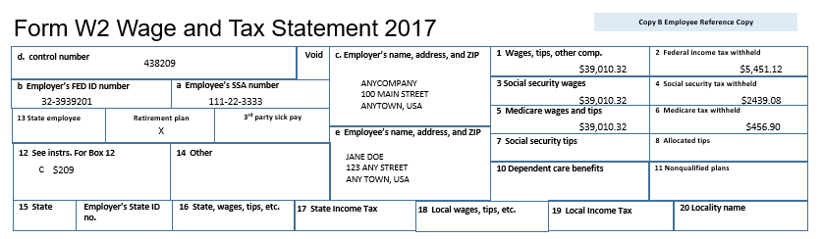
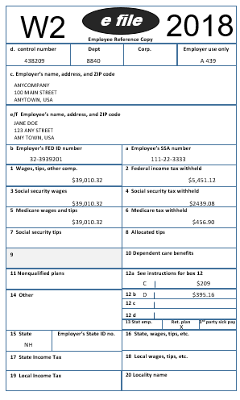
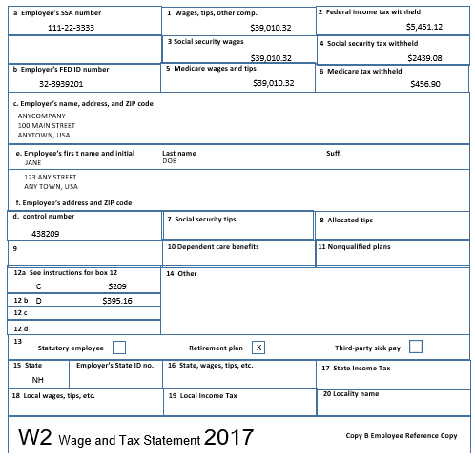
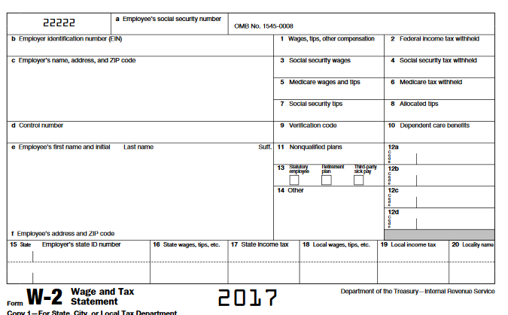
Challenges for processing documents

Slide 69
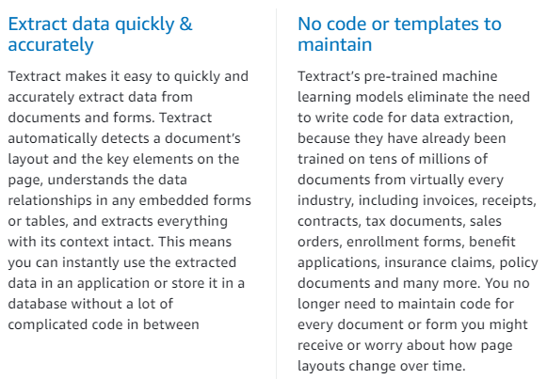
Amazon Textract Text Extraction simplified
Multi-column detection
Output
Extract data quickly &
accurately
No code or templates to
maintain

Slide 70
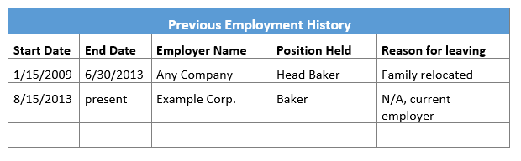
Amazon Textract Table Extraction simplified
Table Recognized
Words grouped by cell
Output
{
Start Date: 1/15/2009
End Date: 6/30/2013
Employer Name: Any Company
Position Held: Head Baker
Reason for leaving: Family relocated
}

Slide 71
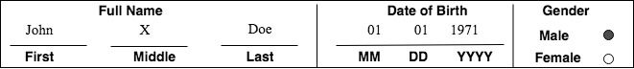
Amazon Textract Form Extraction simplified
Logical grouping captured
Relationships captured
Output
Full Name:
First: John
Middle: X
Last: Doe
Date of Birth:
MM: 01
DD: 01
YYYY: 1971
Gender:
Male: True
Female: False
Glyphs captured

Slide 72
The AWS ML Stack Broadest and most complete set of machine learning capabilities
AI SERVICES
HEALTH AI
INDUSTRIAL AI
ANOMALY DETECTION
CODE AND DEVOPS
NEW
Amazon HealthLake
Amazon Transcribe for Medical
Amazon Comprehend for Medical
NEW
AWS Panorama + Appliance
NEW
Amazon Monitron
NEW
Amazon Lookout for Equipment
NEW
Amazon Lookout for Vision
NEW
Amazon Lookout for Metrics
NEW
Amazon DevOps Guru
Amazon CodeGuru
 | VISION | SPEECH | TEXT | SEARCH | CHATBOTS | PERSONALIZATION | FORECASTING | FRAUD | CONTACT CENTERS
Amazon Rekognition
Amazon Polly
Amazon Transcribe
+Medical
Amazon Comprehend
+Medical
Amazon Translate
Amazon Textract
Amazon Kendra
Amazon Lex
Amazon Personalize
Amazon Forecast
Contact Lens
Amazon Fraud Detector
Voice ID
For Amazon Connect
ML SERVICES
SAGEMAKER STUDIO IDE
Label data | NEW Aggregate & prepare data | NEW Store & share features | Auto ML | Spark/R | NEW Detect bias | Visualize in notebooks | Pick algorithm | Train models | Tune parameters | NEW Debug & profile | Deploy in production | Manage & monitor | NEW CI/CD | Human review
Amazon SageMaker
NEW: SageMaker JumpStart
NEW: Model management for edge devices
FRAMEWORKS & INFRASTRUCTURE
Deep Learning AMIs & Containers | GPUs & CPUs | Elastic Inference | Trainium | Inferentia | FPGA
DeepGraphLibrary
Notes:
Speaker Notes
1/ As you know, AWS offers builders with the right tools for the right job and provides them their choice of tools.
2/ When it comes to AI & Machine Learning, AWS offers a broad and deep set of services and supporting cloud infrastructure so that we can put machine learning in the hands of every developer, data scientist and expert practitioner.
3/ SageMaker is the middle of our 3-tier stack, and is intended for anyone who is looking to build, train, and deploy their own custom machine learning models.
Speaker Guidance
This slide should be presented quickly. By the time you are delivering this presentation to your audience, you should know that they want to specifically dive deep into SageMaker.

Slide 73
ML & Humans work together for multiple use cases
Image Moderation | Form Data Extraction | Customer Support | Media Analysis
Invoice Processing | Loan Approval | Supplier Payments | Prescription Processing
Dating Applications | Model Accuracy Monitoring | Document Categorization | Advertising Analysis
Preventive Maintenance | Bill Processing | Weather Data Processing | Text Classification

Slide 74
ML & Humans work together for multiple use cases
Image Moderation | Form Data Extraction | Customer Support | Media Analysis
Invoice Processing | Loan Approval | Supplier Payments | Prescription Processing
Dating Applications | ML Model Auditing | Document Categorization | Advertising Analysis
Preventive Maintenance | Bill Processing | Weather Data Processing | Text Classification
What is the key message of this video ad?
Are the subtitles accurately generated by transcription ML models?
Notes:
Summarizing the clip -

Slide 75
ML & Humans work together for multiple use cases
Image Moderation | Form Data Extraction | Customer Support | Media Analysis
Document Processing | Loan Approval | Supplier Payments | Prescription Processing
Dating Applications | ML Model Auditing | Document Categorization | Advertising Analysis
Preventive Maintenance | Bill Processing | Weather Data Processing | Text Classification
Supplier # should be highly accurate
SSN # should be highly accurate

Slide 76
ML & Humans work together for multiple use cases
Image Moderation | Form Data Extraction | Customer Support | Media Analysis
Invoice Processing | Loan Approval | Supplier Payments | Prescription Processing
Dating Applications | ML Model Auditing | Document Categorization | Advertising Analysis
Preventive Maintenance | Bill Processing | Weather Data Processing | Text Classification
Keep your audience safe
Nuanced guidelines for each region
Notes:
Content moderation guidelines are nuanced, highly dependent on the context, and vary between countries. This can make it difficult for ML to maintain high accuracy.

Slide 77
ML & Humans work together for multiple use cases
Image Moderation | Model Accuracy Monitoring | Customer Support | Media Analysis
Invoice Processing | Loan Approval | Supplier Payments | Prescription Processing
Dating Applications | ML Model Auditing | Document Categorization | Advertising Analysis
Preventive Maintenance | Bill Processing | Weather Data Processing | Text Classification
How is ML Model performing?
Identify deviations as data changes

Slide 78







Benefits with Amazon A2I
Easily implement
human review workflows
Reduce time to market
with pre-built workflows
and UIs
Multiple workforce
options
Integrate with
your custom ML
models
Pre-built algorithms to
increase accuracy

Slide 79
Human Review Workforces
Amazon Mechanical Turk
Private
Vendors
An on-demand 24x7 workforce of over 500,000 independent contractors worldwide, powered by Amazon Mechanical Turk
A team of workers that you have sourced yourself (your own employees or contractors)
AWS Marketplace vendors that specialize in human review tasks

Slide 80



How Amazon A2I works
High-confidence predictions returned immediately to client application
3
Client Application
1
Client application
sends input data
2
AWS AI Service or custom ML model makes predictions
4
Low confidence predictions sent for human review
Reviews consolidated
using A2I answer
consolidation algorithms
5
6
Results stored to your S3

Slide 81

“The NHS has long been interested in the promise of AI to improve the quality of public healthcare. Human judgement is critical and in fact is often required for decisions involving medical payments. Amazon Textract is compelling because it offers AI-powered extraction of text and structured data from virtually any document. We are excited about Amazon Augmented AI because it allows us to take advantage of machine learning while still applying human judgement. That’s a game changer for us.”
– Chris Suter, Head of Cloud Platforms and Innovation, NHS BSA
Notes:
National Health Service, Business Services Authority (NHS BSA) is part of the UK National Health Service. It provides a range of support services to NHS organizations, NHS contractors and patients. As part of its payment services, they process 54 million paper prescriptions and other healthcare documents per month.

Slide 82
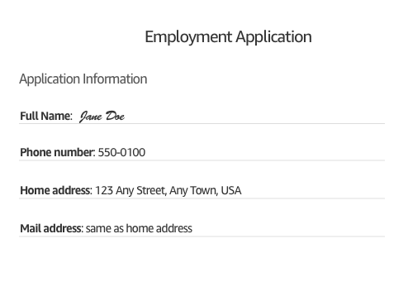


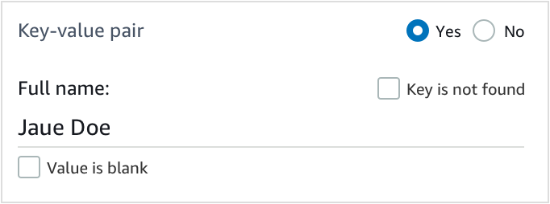
Example: Incorrect Spelling Identified
ML Confidence < 80%
Input
Amazon
Textract
Incorrect spelling identified

Slide 83
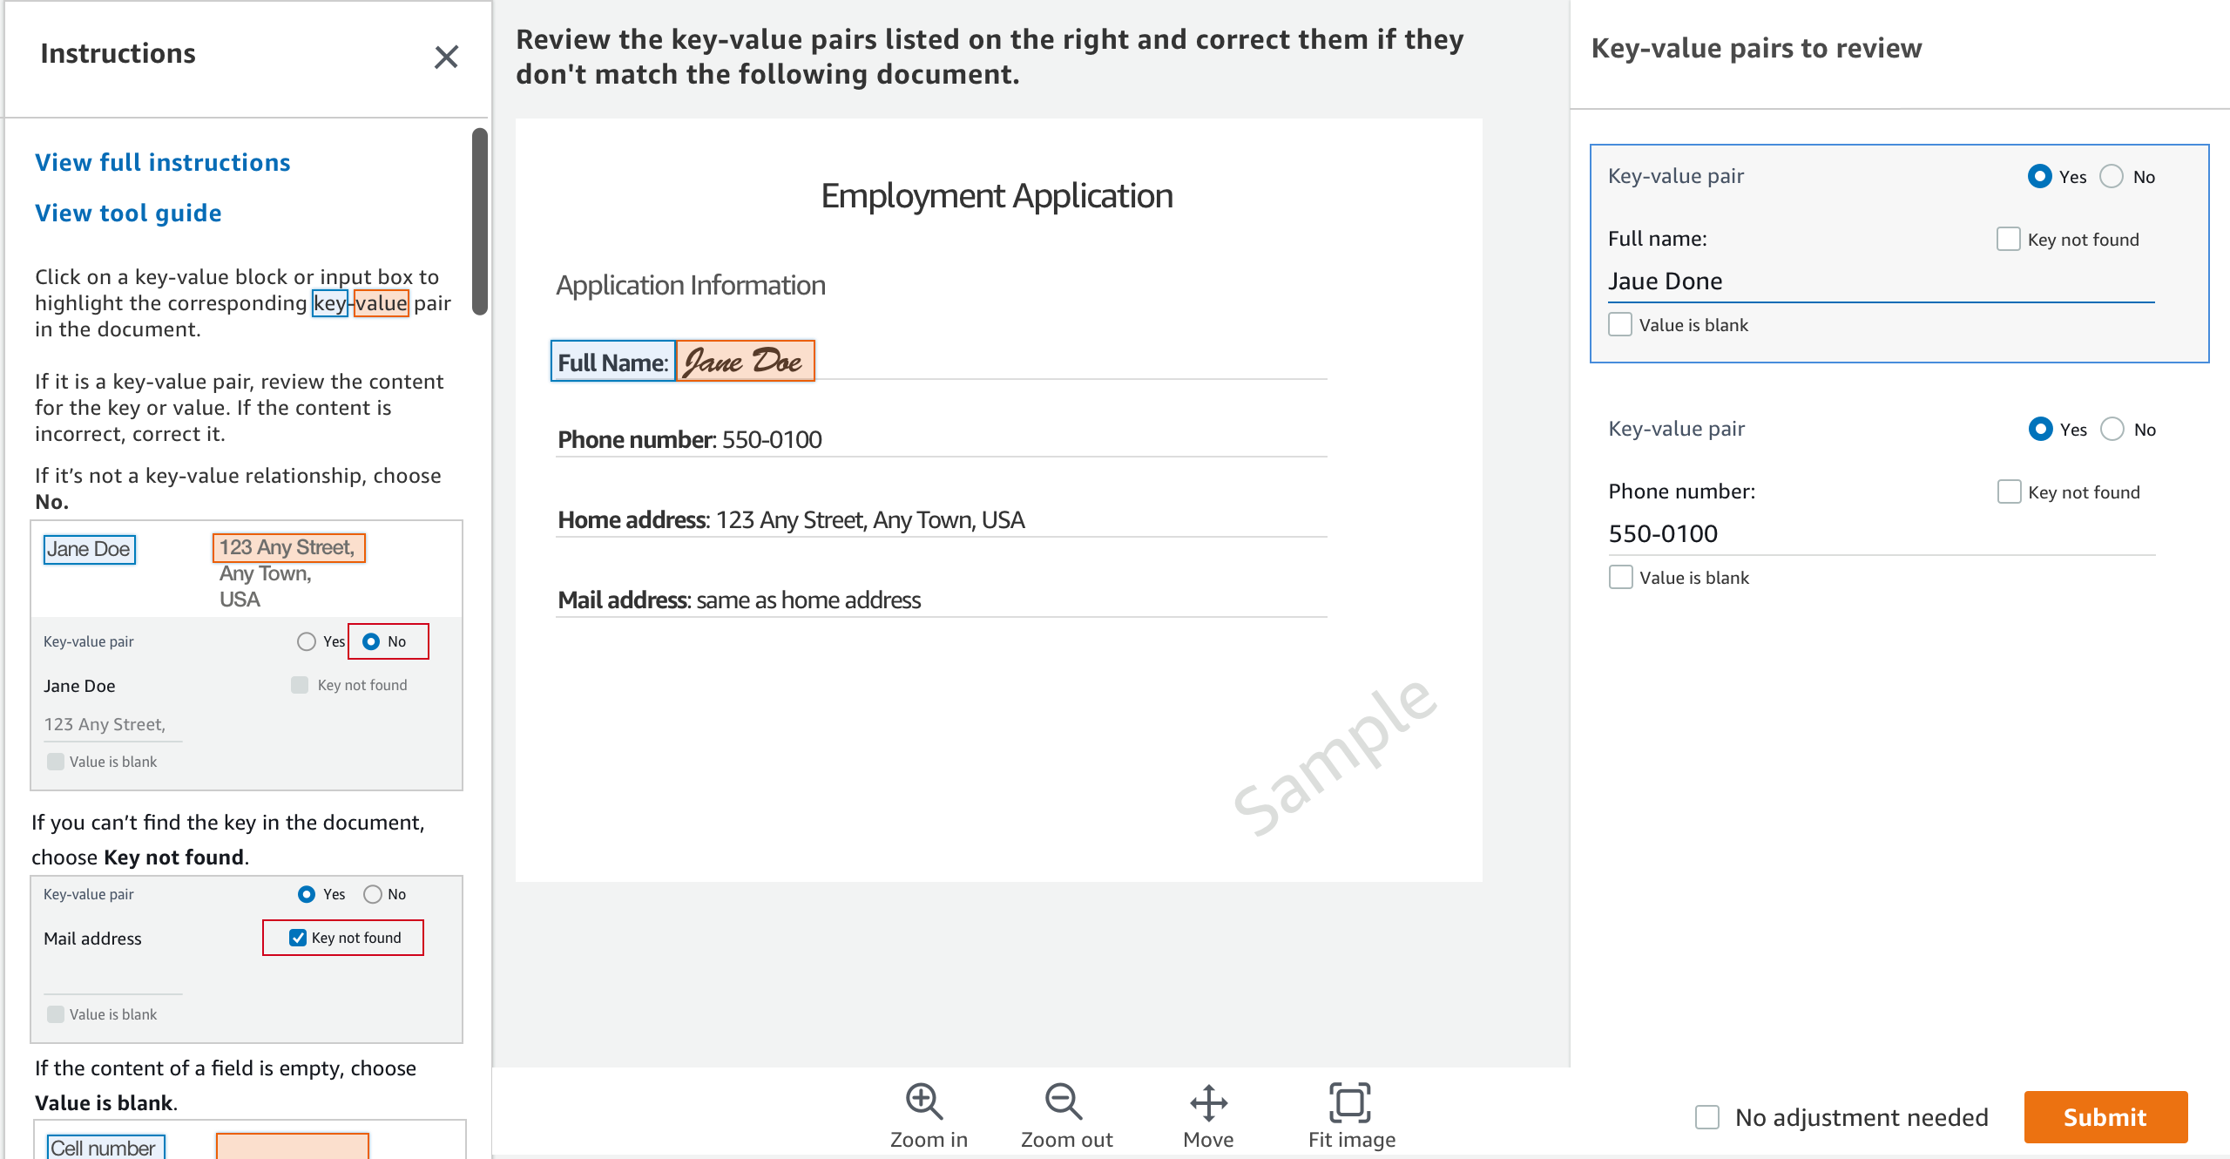
Pre-built UI for form data extraction
Jaue

Slide 84

Humans review only a subset of data
Jane

Slide 85
The AWS ML Stack Broadest and most complete set of machine learning capabilities
AI SERVICES
HEALTH AI
INDUSTRIAL AI
ANOMALY DETECTION
CODE AND DEVOPS
NEW
Amazon HealthLake
Amazon Transcribe for Medical
Amazon Comprehend for Medical
NEW
AWS Panorama + Appliance
NEW
Amazon Monitron
NEW
Amazon Lookout for Equipment
NEW
Amazon Lookout for Vision
NEW
Amazon Lookout for Metrics
NEW
Amazon DevOps Guru
Amazon CodeGuru
 | VISION | SPEECH | TEXT | SEARCH | CHATBOTS | PERSONALIZATION | FORECASTING | FRAUD | CONTACT CENTERS
Amazon Rekognition
Amazon Polly
Amazon Transcribe
+Medical
Amazon Comprehend
+Medical
Amazon Translate
Amazon Textract
Amazon Kendra
Amazon Lex
Amazon Personalize
Amazon Forecast
Contact Lens
Amazon Fraud Detector
Voice ID
For Amazon Connect
ML SERVICES
SAGEMAKER STUDIO IDE
Label data | NEW Aggregate & prepare data | NEW Store & share features | Auto ML | Spark/R | NEW Detect bias | Visualize in notebooks | Pick algorithm | Train models | Tune parameters | NEW Debug & profile | Deploy in production | Manage & monitor | NEW CI/CD | Human review
Amazon SageMaker
NEW: SageMaker JumpStart
NEW: Model management for edge devices
FRAMEWORKS & INFRASTRUCTURE
Deep Learning AMIs & Containers | GPUs & CPUs | Elastic Inference | Trainium | Inferentia | FPGA
DeepGraphLibrary
Notes:
Speaker Notes
1/ As you know, AWS offers builders with the right tools for the right job and provides them their choice of tools.
2/ When it comes to AI & Machine Learning, AWS offers a broad and deep set of services and supporting cloud infrastructure so that we can put machine learning in the hands of every developer, data scientist and expert practitioner.
3/ SageMaker is the middle of our 3-tier stack, and is intended for anyone who is looking to build, train, and deploy their own custom machine learning models.
Speaker Guidance
This slide should be presented quickly. By the time you are delivering this presentation to your audience, you should know that they want to specifically dive deep into SageMaker.

Slide 86




BETTER INSIGHTS LEAD TO BETTER CUSTOMER SERVICE
WITH CONTACT LENS FOR AMAZON CONNECT
Transcribes live
and archived calls
Enhanced search
on call and chat
transcripts,
sentiment scores,
silence duration etc.
Custom categorization
to Identify common
call types
Prioritized
list of recurring
issues based on
customer feedback
Real time
dashboard and
alerting for supervisors
Provide
agents with
answers to questions
as they are being
asked
Notes:
Lastly, we introduced Contact Lens for Amazon Connect, a fully-managed add-on that allows customers of Amazon Connect, our cloud contact center service
Use the power of ML without requiring any technical skills to do things such as identify common call types, identify recurring themes based on customer call feedback, alert supervisors when customers are having a poor experience, and assist agents with a knowledge base to answer questions as they are being asked.

Slide 87
The AWS ML Stack Broadest and most complete set of machine learning capabilities
AI SERVICES
HEALTH AI
INDUSTRIAL AI
ANOMALY DETECTION
CODE AND DEVOPS
NEW
Amazon HealthLake
Amazon Transcribe for Medical
Amazon Comprehend for Medical
NEW
AWS Panorama + Appliance
NEW
Amazon Monitron
NEW
Amazon Lookout for Equipment
NEW
Amazon Lookout for Vision
NEW
Amazon Lookout for Metrics
NEW
Amazon DevOps Guru
Amazon CodeGuru
 | VISION | SPEECH | TEXT | SEARCH | CHATBOTS | PERSONALIZATION | FORECASTING | FRAUD | CONTACT CENTERS
Amazon Rekognition
Amazon Polly
Amazon Transcribe
+Medical
Amazon Comprehend
+Medical
Amazon Translate
Amazon Textract
Amazon Kendra
Amazon Lex
Amazon Personalize
Amazon Forecast
Contact Lens
Amazon Fraud Detector
Voice ID
For Amazon Connect
ML SERVICES
SAGEMAKER STUDIO IDE
Label data | NEW Aggregate & prepare data | NEW Store & share features | Auto ML | Spark/R | NEW Detect bias | Visualize in notebooks | Pick algorithm | Train models | Tune parameters | NEW Debug & profile | Deploy in production | Manage & monitor | NEW CI/CD | Human review
Amazon SageMaker
NEW: SageMaker JumpStart
NEW: Model management for edge devices
FRAMEWORKS & INFRASTRUCTURE
Deep Learning AMIs & Containers | GPUs & CPUs | Elastic Inference | Trainium | Inferentia | FPGA
DeepGraphLibrary
Notes:
Speaker Notes
1/ As you know, AWS offers builders with the right tools for the right job and provides them their choice of tools.
2/ When it comes to AI & Machine Learning, AWS offers a broad and deep set of services and supporting cloud infrastructure so that we can put machine learning in the hands of every developer, data scientist and expert practitioner.
3/ SageMaker is the middle of our 3-tier stack, and is intended for anyone who is looking to build, train, and deploy their own custom machine learning models.
Speaker Guidance
This slide should be presented quickly. By the time you are delivering this presentation to your audience, you should know that they want to specifically dive deep into SageMaker.

Slide 88
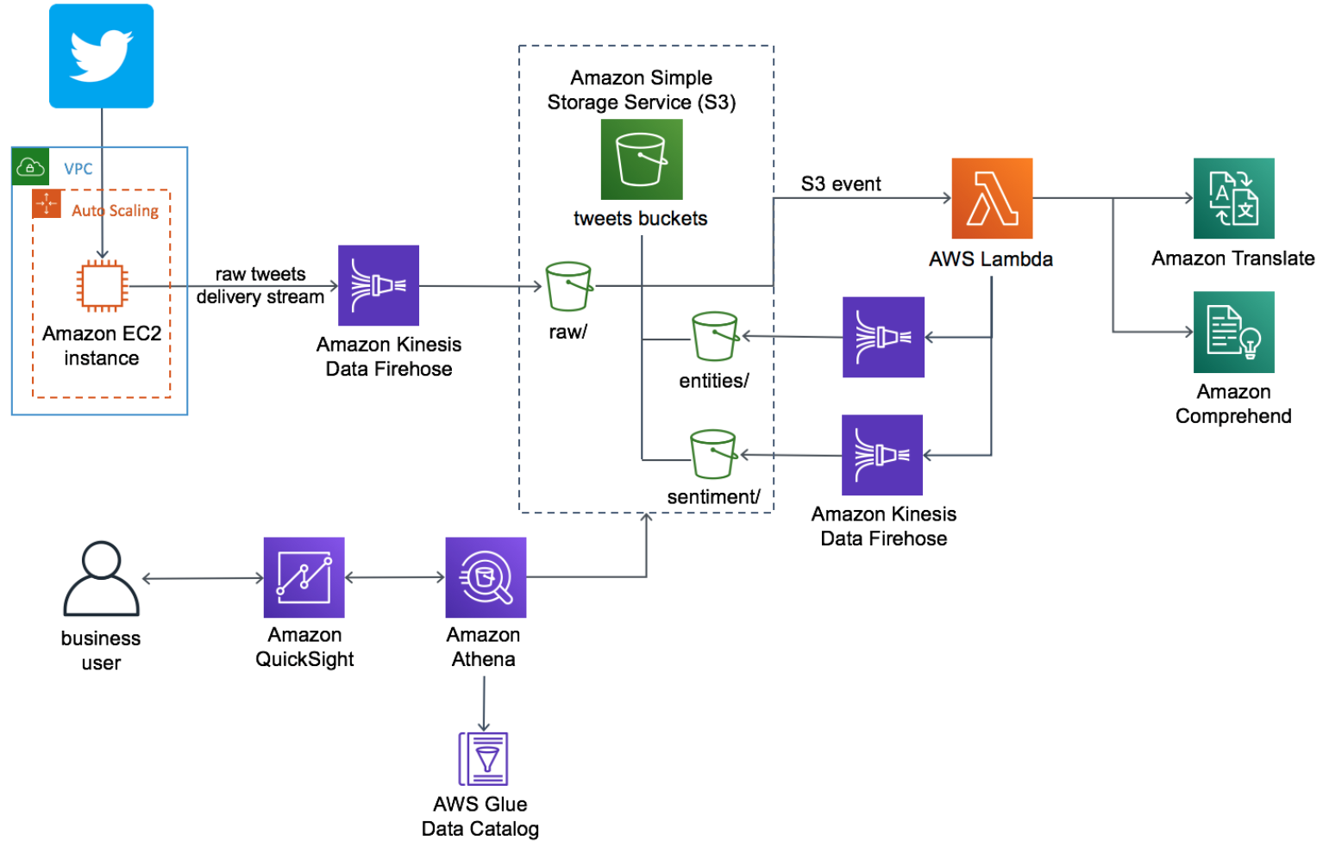
AI-Driven Social Media Dashboard
Notes:
https://aws.amazon.com/blogs/machine-learning/build-a-social-media-dashboard-using-machine-learning-and-bi-services/
https://aws.amazon.com/solutions/implementations/ai-driven-social-media-dashboard/

Slide 89
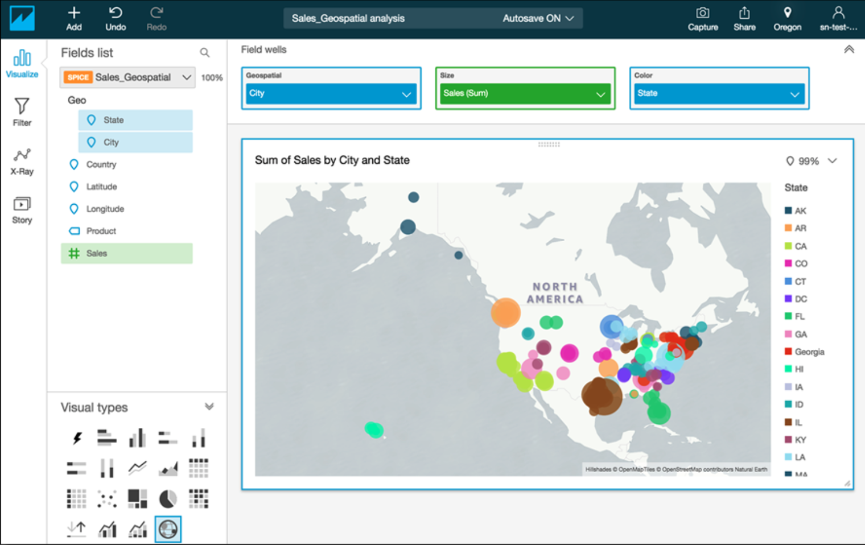
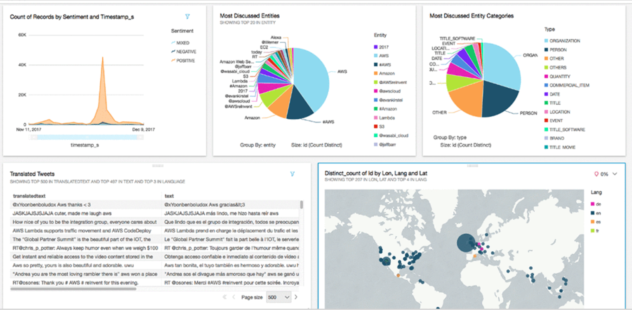
AI-Driven Social Media Dashboard

Slide 90
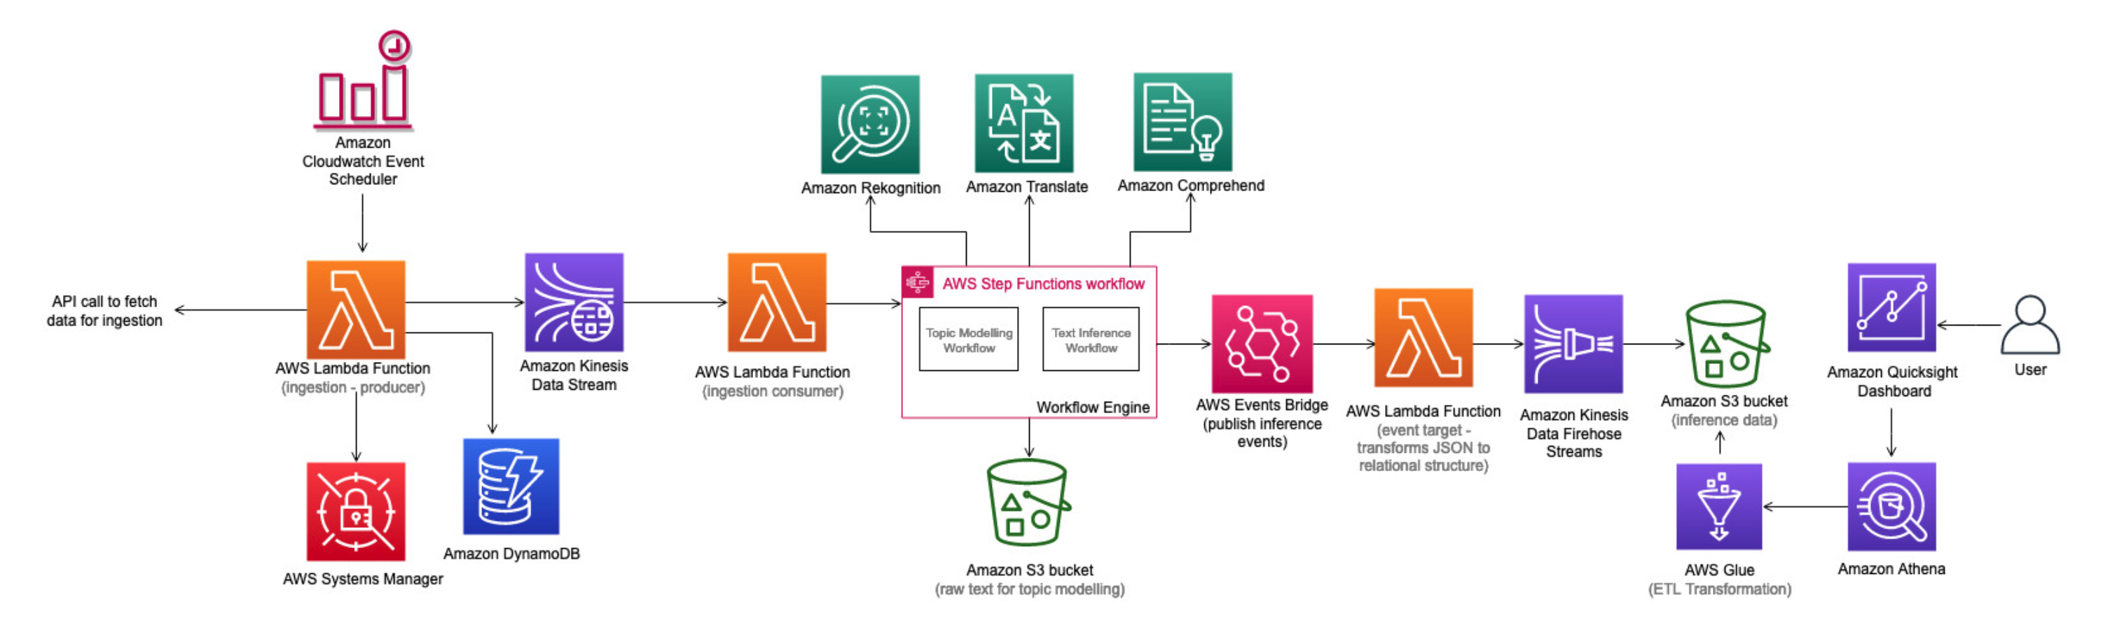
Discovering Hot Topics using Machine Learning
Notes:
Performs topic modeling to detect dominant topics: identifies the terms that collectively form a topic from within customer feedback
Identifies the sentiment of what customers are saying: uses contextual semantic search to understand the nature of online discussions
Determines if images associated with your brand contain unsafe content: detects unsafe and negative imagery in content
Helps customers identify insights in near real-time: uses a visualization dashboard to better understand context, threats, and opportunities almost instantly

Slide 91
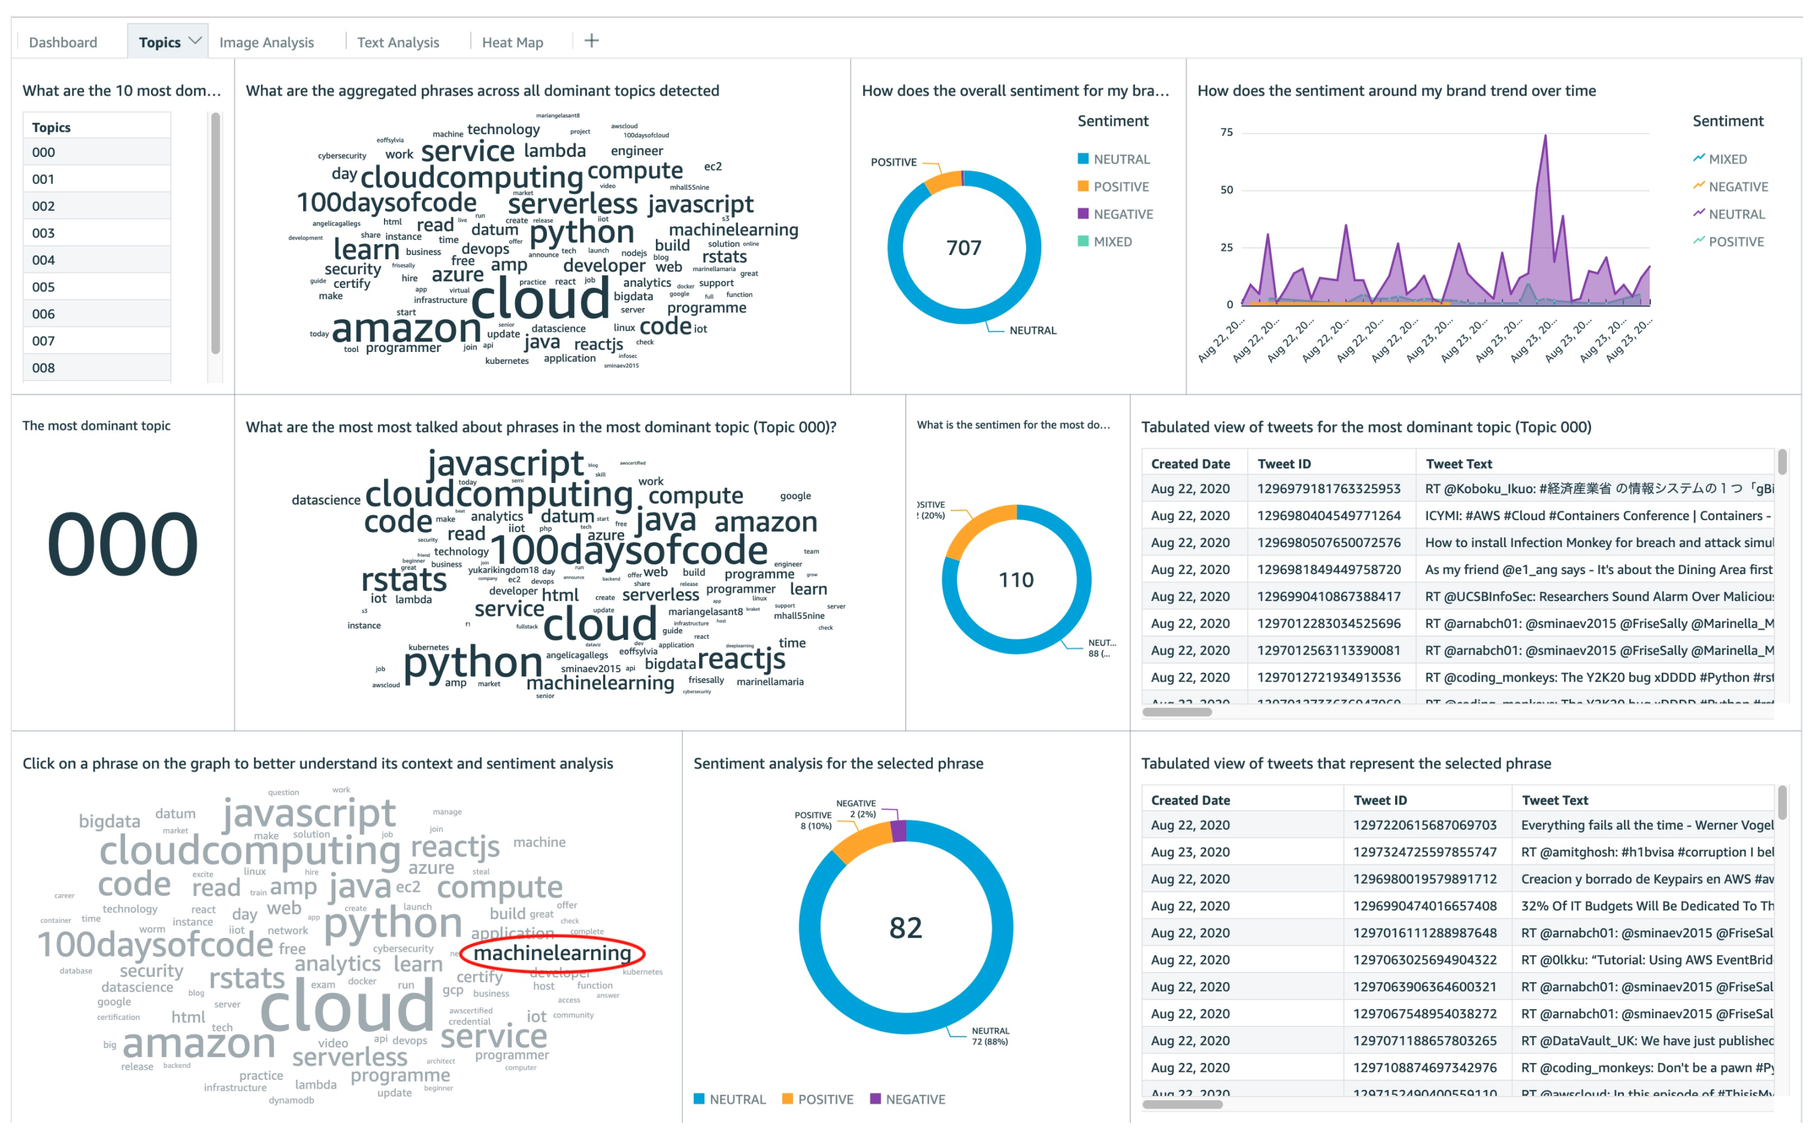
Discovering Hot Topics using Machine Learning
Notes:
https://aws.amazon.com/solutions/implementations/discovering-hot-topics-using-machine-learning/?did=sl_card

Slide 92

Making history fun
The White House Historical Association uses Amazon Rekognition to power the Presidential Lookalike tool, letting users upload a selfie to see which President or First Lady they most resemble.
Notes:
The White House Historical Association is a private, non-profit organization with a mission to enhance the public's understanding, appreciation, and enjoyment of the White House. They use Amazon Rekognition to power the Presidential Lookalike tool, letting users upload a selfie to see which President or First Lady they most resemble.
More: https://aws.amazon.com/solutions/case-studies/white-house-historical-association/
#AMER
#PUBLICSECTOR

Slide 93

Inspiring future astronauts
NASA uses Amazon Lex to power the voice interface for Rov-E, their educational robot. Rov-E helps inspire the next generation of explorers by visiting schools, community organizations, and other public outreach events.
Notes:
To inspire the next generation of explorers, NASA reaches out to students in schools, community organizations, and public events. A star robotic ambassador is “Rov-E,” a close replica of real NASA Mars rovers.
Through Amazon Lex, NASA staff can now easily navigate Rov-E via voice commands — an effective conversational interface when speaking with large crowds. Multi-turn dialog management capability enables Rov-E "to talk,” answering students’ questions about Mars in an engaging way.
Integration with AWS services allows Rov-E to connect and scale with various data sources to retrieve NASA’s Mars exploration information.
#AMER
#PUBLICSECTOR

Slide 94
Thank You

